Slide 1
Tourism in Europe
“One’s destination is never a place, but a new way of seeing things”.
Henry Miller

Slide 2
Tourism in Europe
1.1. Basic concepts of tourism
Conceptual approach to tourism
Individual or group travel (at least 24-hour stay), in order to satisfy entertainment needs.
People visit tourist destinations for touristic purposes, that is, for purposes other than those of permanent residence or profession.
Travel to various tourist destinations is temporary and short-term.
Travel and stay take place at a place other than permanent residence.

Slide 3
Tourism in Europe
1.2. Factors contributing to the high increase in tourism after 1950
● The growing urbanization of the population
Factors contributing to the high increase in tourism after 1950:
● The rising standard of living, which provides opportunities for entertainment expenses.
● The improvement in transportation networks (especially airlines, since the aeroplane is the main means of transport for international tourism) and affordable ticket prices.

Slide 4
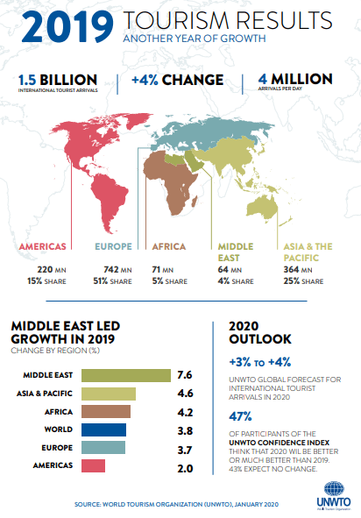
Tourism in Europe
1.2. Factors contributing to the high increase in tourism after 1950

Slide 5
Tourism in Europe
1.3. Types of tourism
Mass
tourism
Domestic tourism
International tourism (inbound & outbound)
Alternative tourism

Slide 6
Tourism in Europe
1.4. Impacts of tourism
1.4.1. Positive impact
Increase in employment
Increase in income
Economic development
Improvement in quality of life
Culture promotion
Infrastructure development

Slide 7
Tourism in Europe
1.4. Impacts of tourism
1.4.1. Positive impacts
Directly involved production sectors:
Tourism offices
Tourist items trade
Healthcare sector
Telecommunications
Tourist items industries
Restaurants, bars, cafeterias, etc.

Slide 8
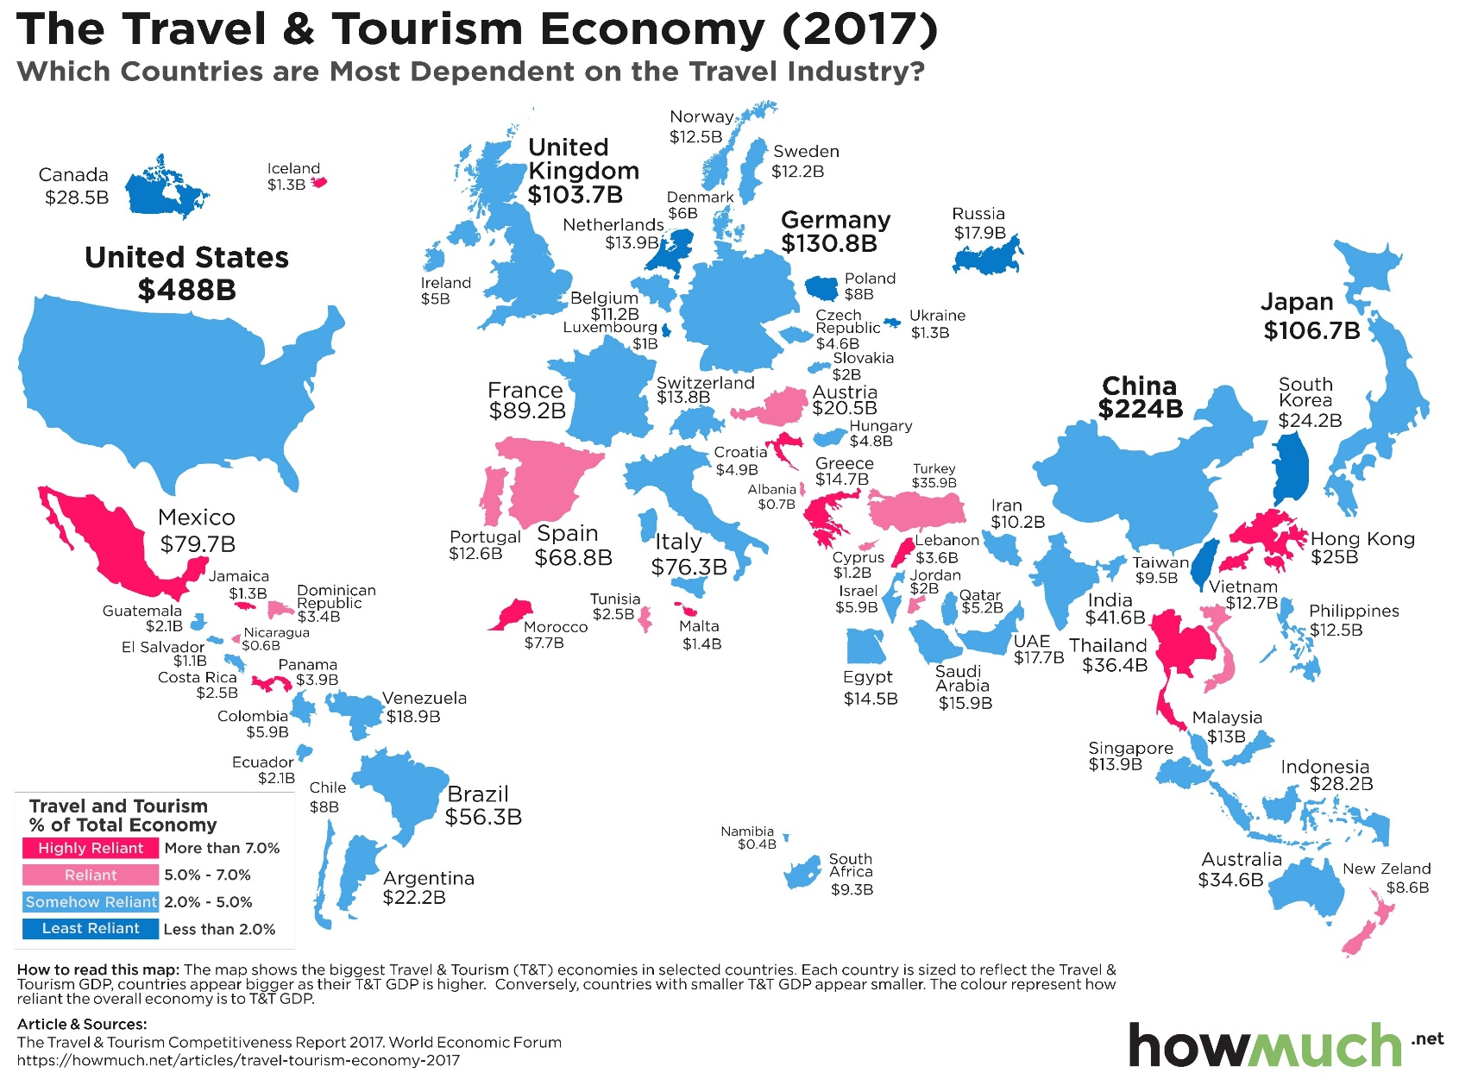
Tourism in Europe
1.4. Impacts of tourism
1.4.1. Positive impacts

Slide 9
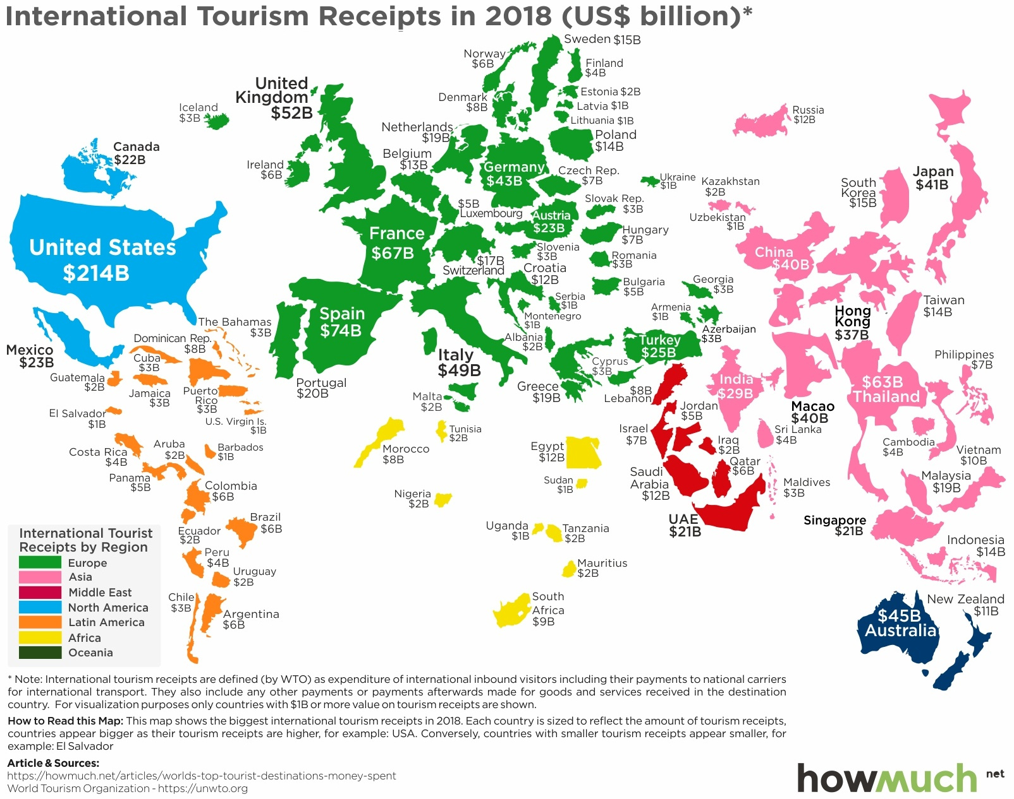
Tourism in Europe
1.4. Impacts of tourism
1.4.1. Positive impacts

Slide 10
Tourism in Europe
1.4. Impacts of tourism
1.4.2. Negative impacts
→ Distortion of cultural characteristics, habits and customs of the host country.
→ Degradation of the natural environment.
→ Increase in the value of land and products.
→ Faster depletion of natural resources.
→ Unemployment during off-seasons, since local economies aim at tourism and lack other employment opportunities.

Slide 11
Tourism in Europe
1.5. Factors contributing to an increase in tourism
Factors contributing to an increase in tourism
Geographical location
Cost of living
Organization of tourist services
Climate
Natural Environment
Cultural Environment
Transportation infrastructure

