Slide 1
Tourism in Europe
“One’s destination is never a place, but a new way of seeing things”.
Henry Miller

Slide 2
Tourism in Europe
1.6. The European tourist market
European tourist market
Europe is one of the most important destinations for tourists worldwide.
One in four tourists worldwide head for the European Mediterranean coasts alone.
France is the first country worldwide with the highest number of tourist arrivals.
Spain is the first European country and second worldwide in revenues from tourism, surpassing France.
Most visited countries of the continent are Italy, Austria, U.K., Germany, Greece etc
Europe attracts a big number of tourists from other continents (U.S.A., Asia etc)

Slide 3
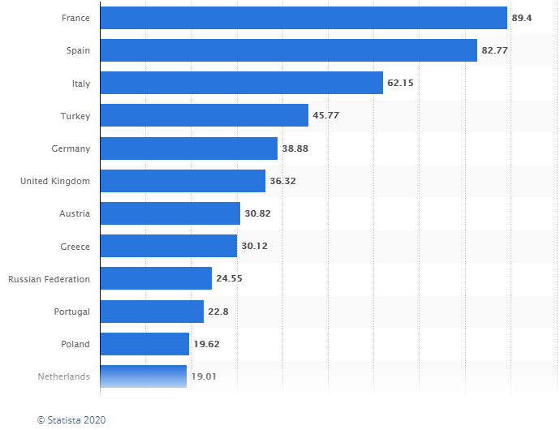
Tourism in Europe
1.6. The European tourist market
European countries with the largest number of international tourist arrivals in 2019.

Slide 4
Tourism in Europe
1.6. The European tourist market
The ski resorts of the European mountainous regions, where visitors can go skiing in winter but also do other winter sports, while during the rest of the year they can enjoy the exquisite natural landscapes, go mountaineering, rest at resorts of picturesque lakes etc.
The big cities, which attract visitors throughout the year, with a plethora of monuments, their long history, modern shopping malls, cultural events etc.
The Mediterranean coasts, which attract a big number of visitors in the summer because of the sun and the sea (over 150 million visitors).

Slide 5
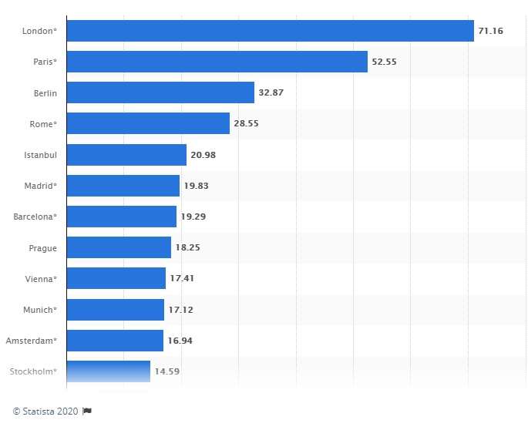
Tourism in Europe
1.6. The European tourist market
Leading European city tourism destinations in 2019.

Slide 6
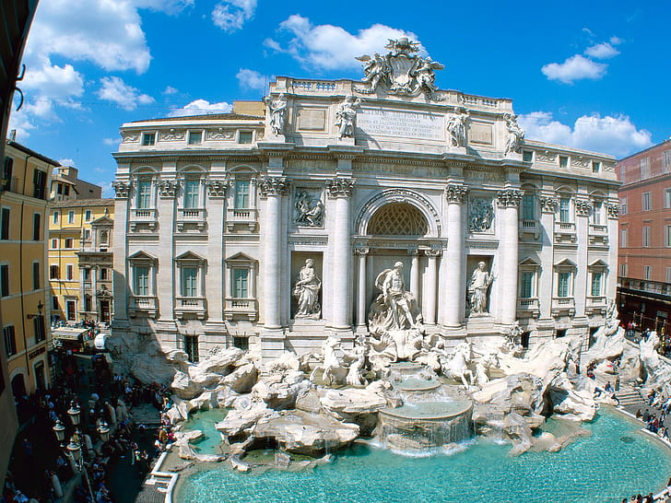
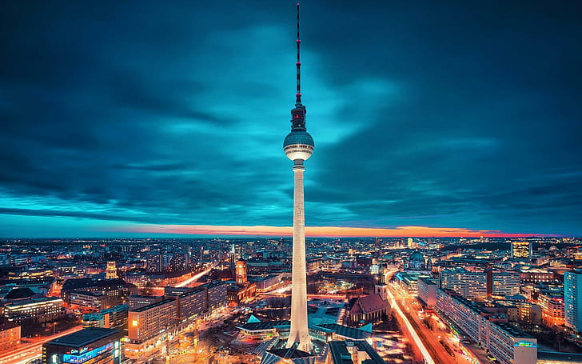
Tourism in Europe
1.6. The European tourist market
London
Paris
Rome
Berlin

Slide 7
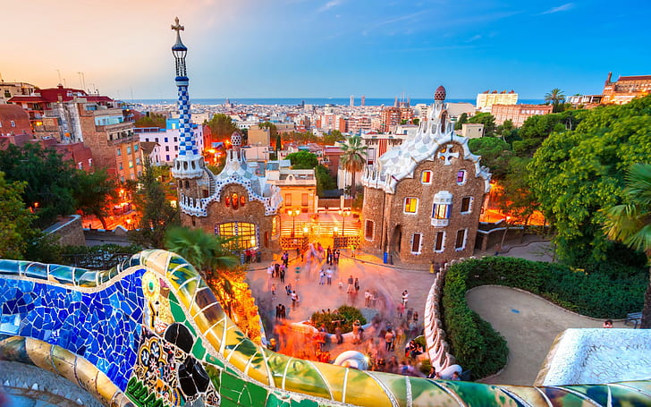
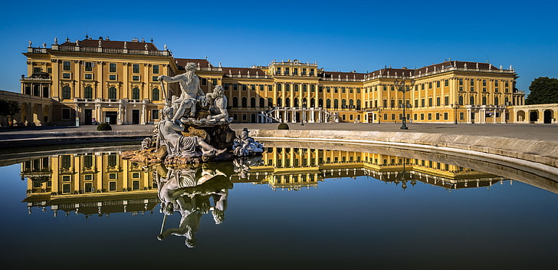
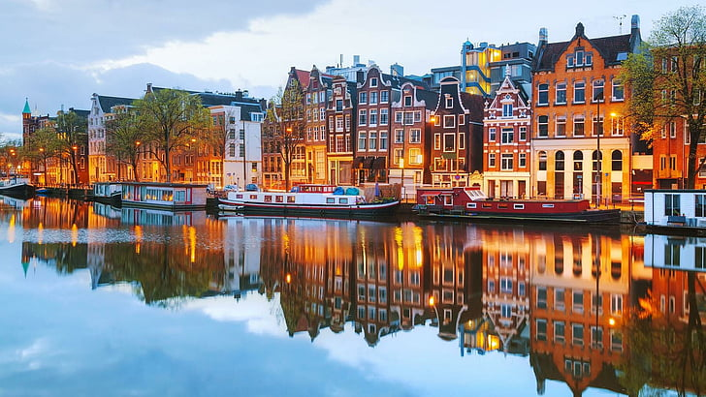
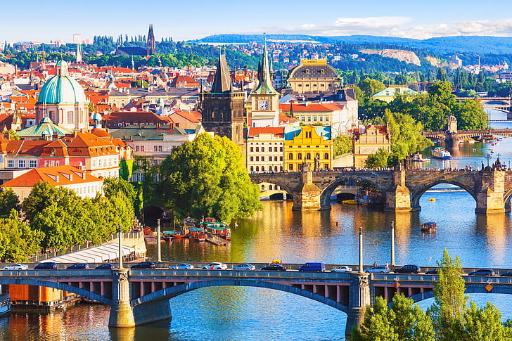
Tourism in Europe
1.6. The European tourist market
Barcelona
Vienna
Amsterdam
Prague

Slide 8
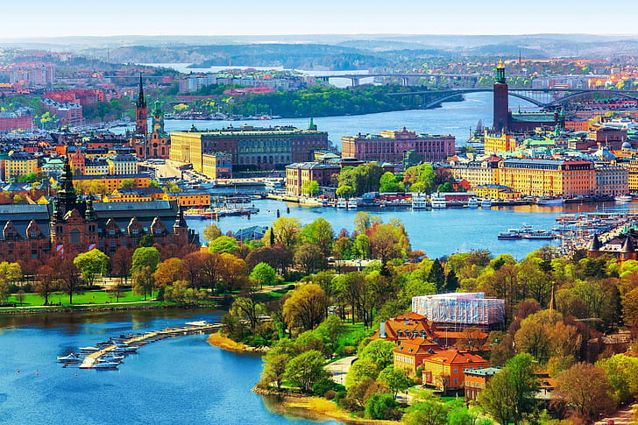
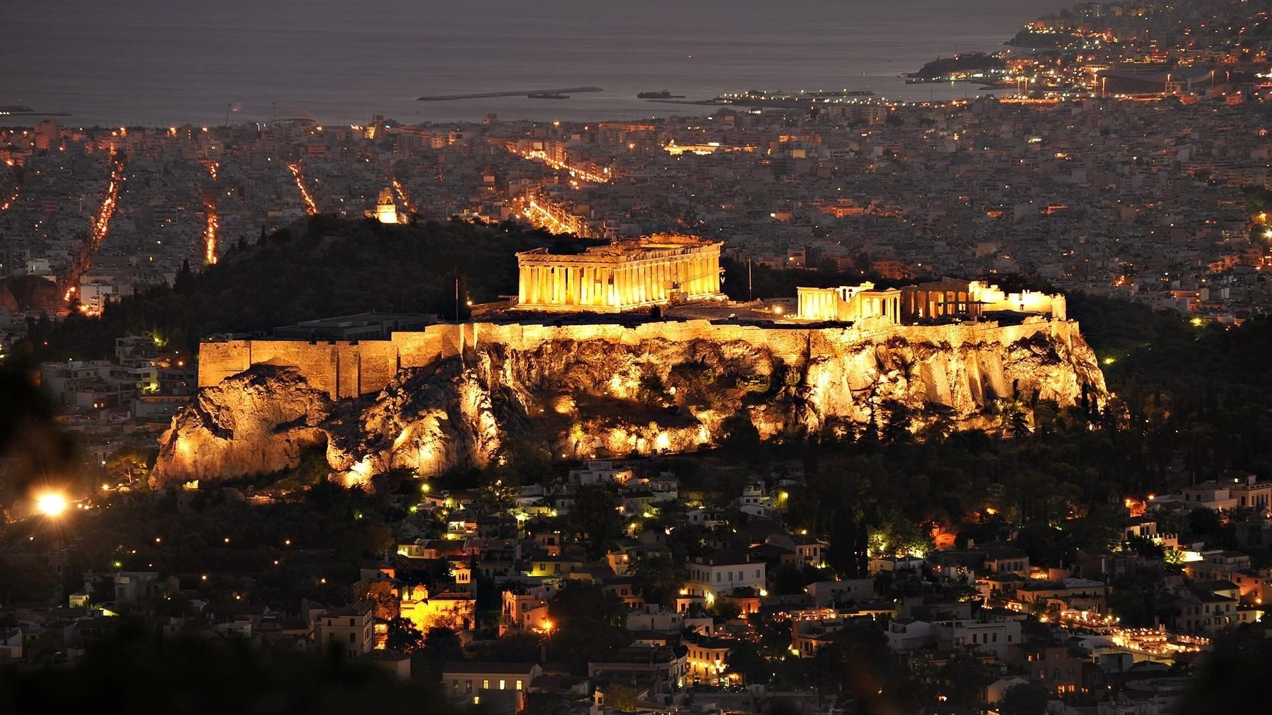
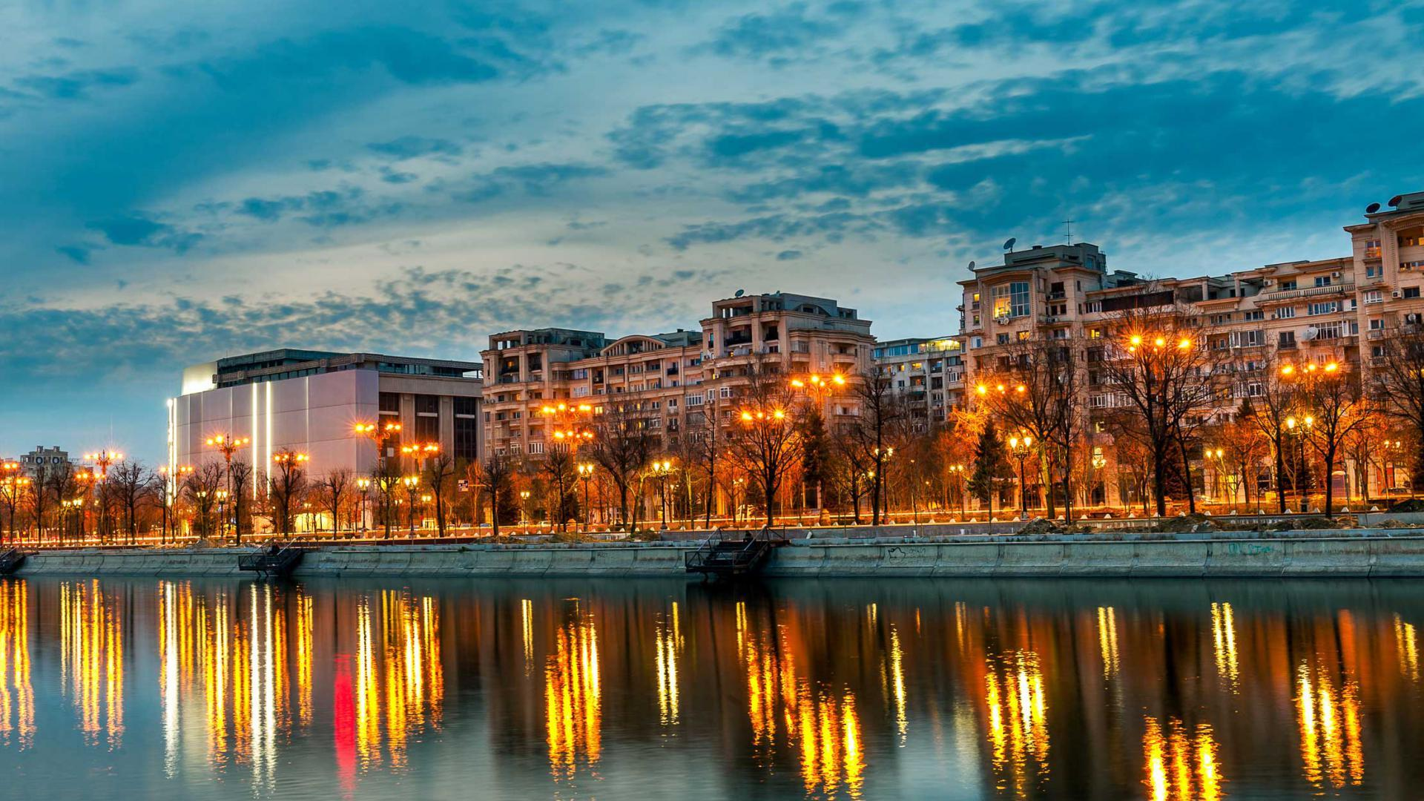
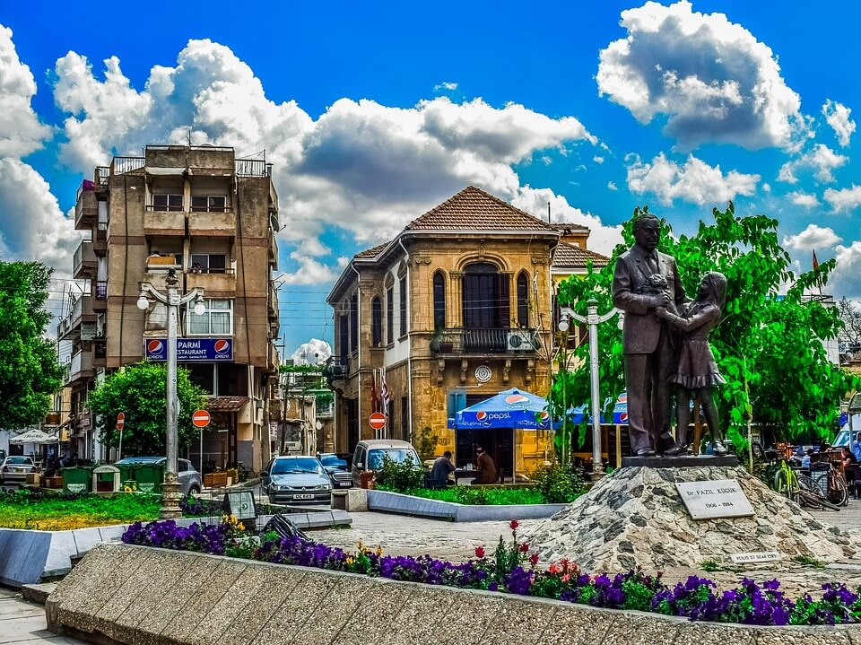
Tourism in Europe
1.6. The European tourist market
Stockholm
Athens
Bucharest
Nicosia

Slide 9
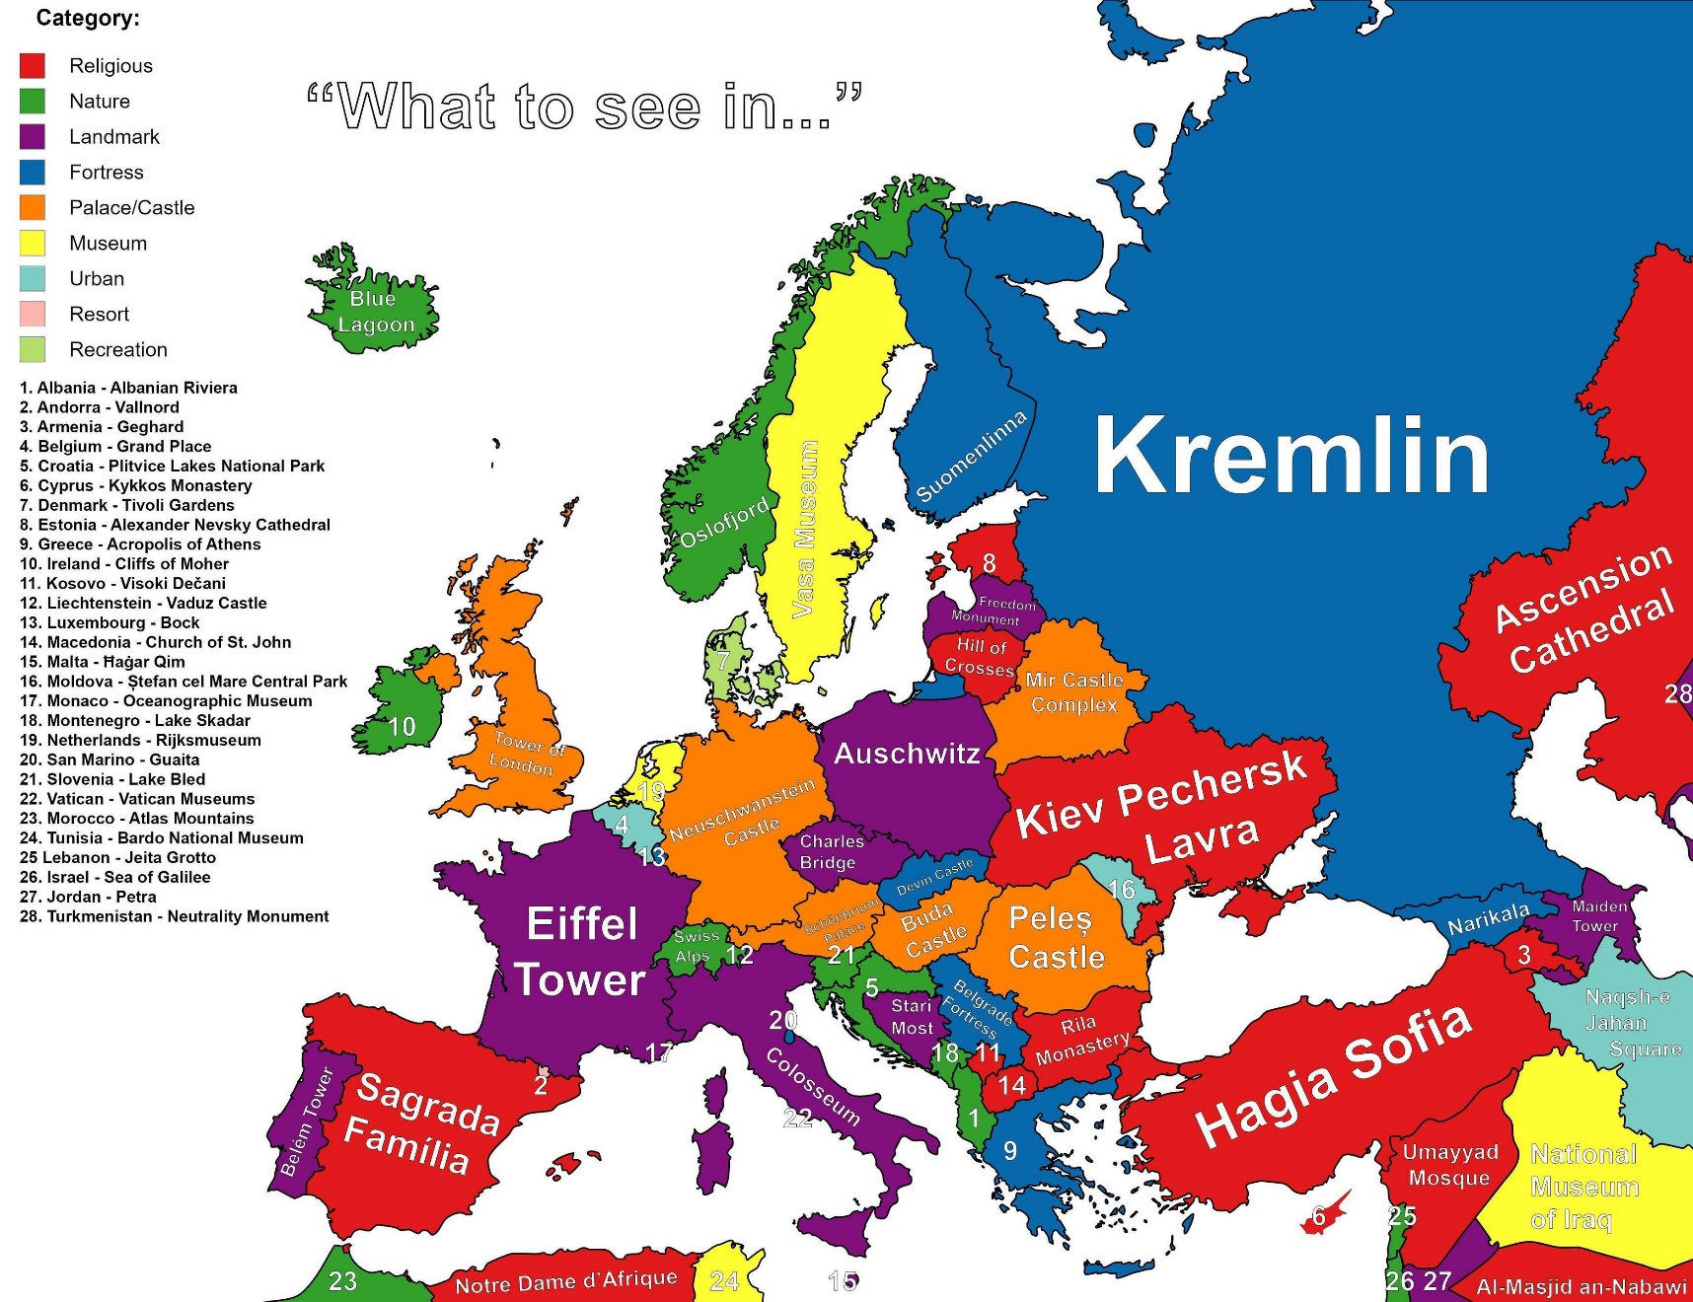
Tourism in Europe
1.6. The European tourist market

Slide 10
Tourism in Europe
1.7. The Greek tourist market
Abundance and diversity of natural resources which allow for 12-month tourism.
Creation of significant businesses which offer enriched product in order to attract special tourist interest.
Advantages of Greek tourism:
High and positive recognition.
Exceptional natural beauties and mild, people-friendly Mediterrαnean climate.
Rich production of traditional products of the primary and secondary sector.
Its presence in Europe, the main destination of world tourism, and its immediate vicinity with other countries of special tourist interest.
Unique historic and cultural origins which fascinate the world.

Slide 11
Tourism in Europe
1.7. The Greek tourist market
Burden on the natural environment.
Decrease in competitiveness of the tourist product, due to the development of new markets, like that of Turkey.
Strong seasonality.
Distortion of cultural characteristics in local societies.
Significant lack of infrastructure, such as transportation, convention venues, etc.
Disadvantages of Greek tourism:
Shortage of qualified personnel.
The vast minority of tourist establishments are small and medium-sized enterprises with limited capacity of promotion, utilization and efficient economic management.

