Slide 1


FREE, RESPONSIBLE & ACTIVE CITIZEN
1.2. Tax compliance
Taxation is the amount of money that citizens and businesses are required to pay to the state, for their income and property or for the activity they carry out.
Direct taxes
They are imposed on income and property.
Indirect taxes
They are imposed on consumer products, e.g. VAT.
They are paid by those who have a certain amount of income or specific assets e.g. income tax, property tax, inheritance tax, etc.
Tax burdens are adjusted to each one’s tax capacity.
They mostly affect low incomes.

Slide 2
FREE, RESPONSIBLE & ACTIVE CITIZEN
1.2. Tax compliance
In Greece, the problem lies in the lack of tax compliance, that is, the denial or the attempt of citizens and businesses to conceal their income & property in order to evade taxes.
Tax evasion
Fake companies
Concealing income
False declarations of expenses

Slide 3
FREE, RESPONSIBLE & ACTIVE CITIZEN
1.2. Tax compliance
Fake companies
Concealing income
E.g. one does not give receipts for the products he sells or the services he provides.
False declarations of expenses
The establishment of fictitious companies based in countries with special tax regime. These countries are called tax havens, as they have little or no tax on foreign investors who will transfer their savings account or funds.
E.g. by using invoices that do not correspond to the purchase of products, a person or a company can seemingly increase costs in order to avoid taxes.
In these countries, many entrepreneurs who want to evade taxes set up offshore companies.

Slide 4
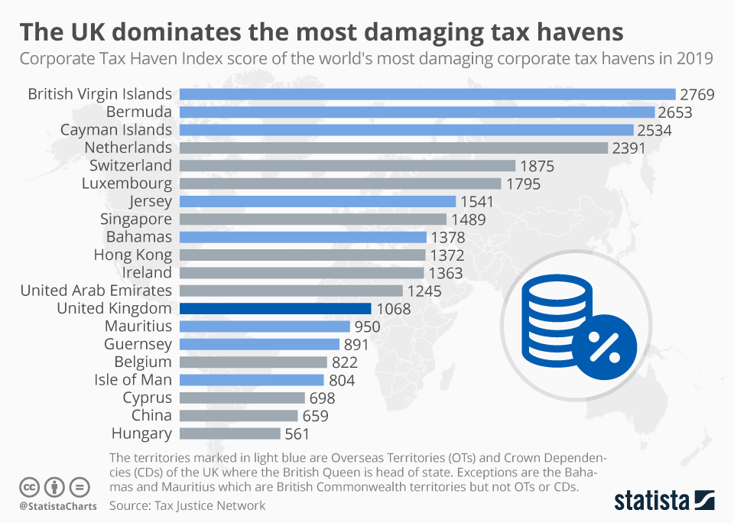
FREE, RESPONSIBLE & ACTIVE CITIZEN
1.2. Tax compliance
1.2.1. Tax havens

Slide 5
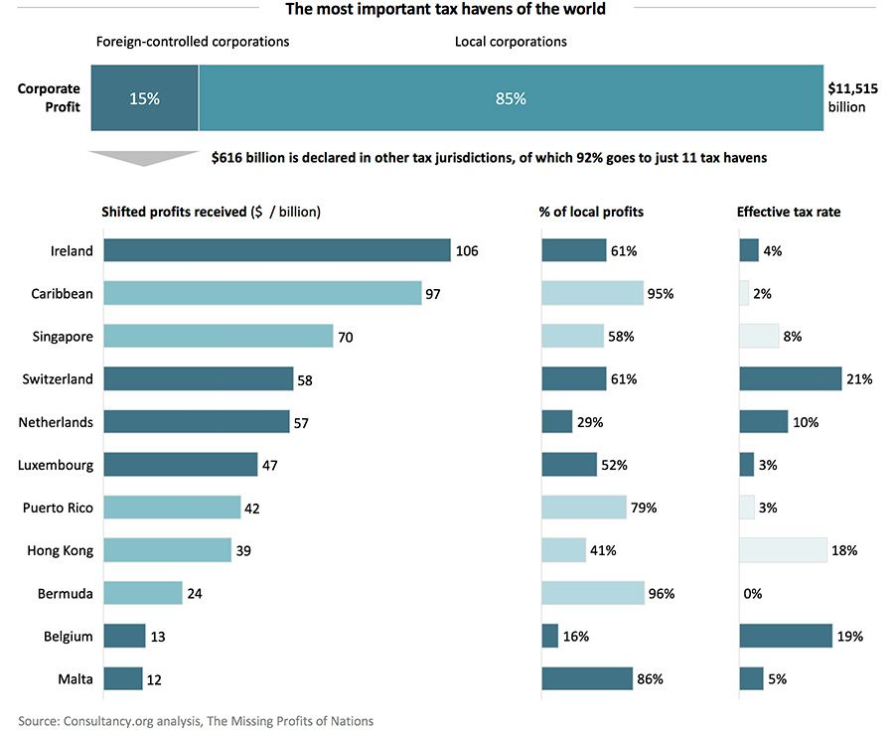
FREE, RESPONSIBLE & ACTIVE CITIZEN
1.2. Tax compliance
1.2.1. Tax havens

Slide 6
FREE, RESPONSIBLE & ACTIVE CITIZEN
1.2. Tax compliance
1.2.2. Tax evasion
→ Tax evasion is a deeply anti-social act.
→ It deprives the state of valuable resources, with which social policy can be implemented (hospitals, schools, public roads, etc.).
The aim of taxation
is to redistribute income
in order to reduce social inequalities.

Slide 7
FREE, RESPONSIBLE & ACTIVE CITIZEN
1.2. Tax compliance
1.2.2. Tax evasion
Tax evasion in Greece is at a high level.
→ Its reduction would create the conditions for expanding the country's social policy.
→ For this reason, it is necessary for the state to intervene both to combat tax evasion and to ensure tax compliance among citizens.
→ Crackdown on tax evasion is absolutely necessary for shaping tax conscience.
→ In an economy of mass tax evasion, a taxpayer who is honest feels wronged.

Slide 8
FREE, RESPONSIBLE & ACTIVE CITIZEN
1.2. Tax compliance
1.2.2. Tax evasion
Transparency in the management of public revenues.
Corruption in the management of public revenues.

Slide 9
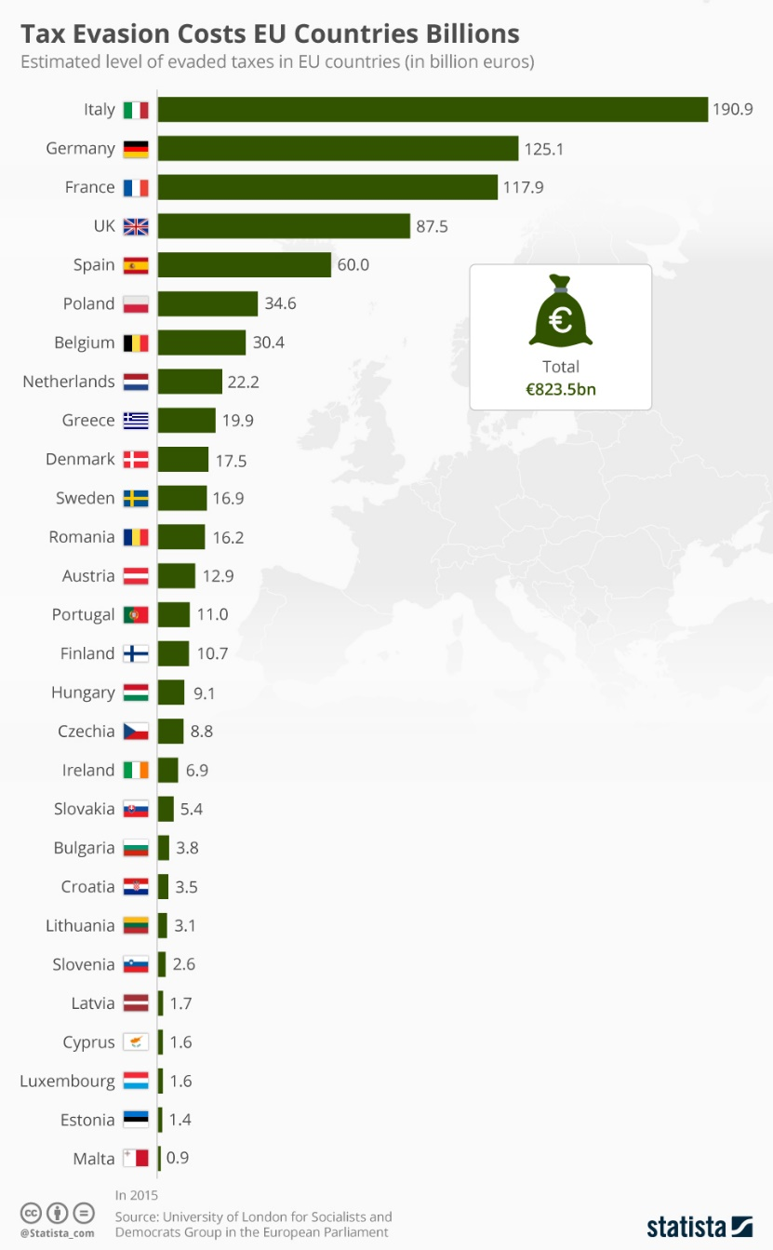
FREE, RESPONSIBLE & ACTIVE CITIZEN
1.2. Tax compliance
1.2.2. Tax evasion

