Slide 1

FREE, RESPONSIBLE & ACTIVE CITIZEN
1.3. Social sensitivity
Α) Children’s rights
The Convention on the Rights of the Child is the first global legally binding Convention on the Rights of the Child.
It sets fundamental principles for the well-being of children at various stages of their development.
It is in effect in almost all countries of the world (contains 54 articles).

Slide 2
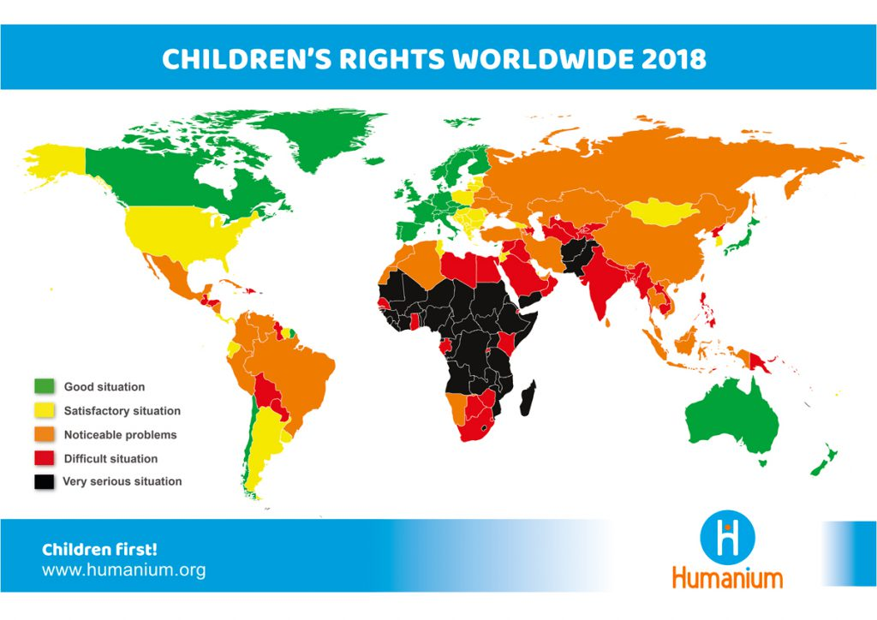
FREE, RESPONSIBLE & ACTIVE CITIZEN
1.3. Social sensitivity
Α) Children’s rights

Slide 3
FREE, RESPONSIBLE & ACTIVE CITIZEN
1.3. Social sensitivity
Α) Children’s rights
Rights to survival
They entail the children's right to life and the needs that are fundamental to their existence.
Rights to protection
Rights to development
They insist that children be protected from all forms of abuse, negligence and exploitation.
They include everything children need to be able to make the most of their potential. For example, the right to education, play and leisure, etc.
Rights to participation
These include a fair standard of living, housing, food and access to medical services.
They entail issues such as special care for refugee children, torture, involvement in war conflicts, child labour, etc.
They allow children to play an active role in their societies and nations. These include the freedom to express an opinion, to have a say in matters concerning their lives, to participate in organizations and to assemble peacefully.

Slide 4
FREE, RESPONSIBLE & ACTIVE CITIZEN
1.3. Social sensitivity
Α) Children’s rights
Convention on the Rights of the Child
It protects all children, regardless of race, colour, sex, language, religion, politics or other beliefs of the child or her/his parents.
"A child means every human being below the age of eighteen years, unless adulthood occurs earlier, in accordance with applicable child law" (UN Convention on the Rights of the Child).
States take all appropriate measures to ensure that the child is effectively protected against any form of discrimination or exploitation.

Slide 5
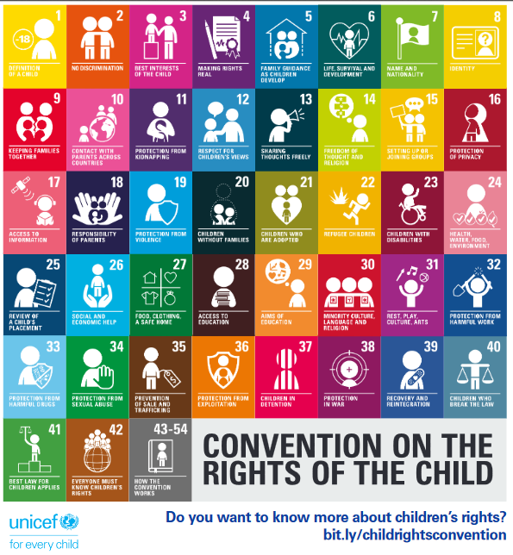
FREE, RESPONSIBLE & ACTIVE CITIZEN
1.3. Social sensitivity
Α) Children’s rights

Slide 6
FREE, RESPONSIBLE & ACTIVE CITIZEN
1.3. Social sensitivity
Β) The rights of persons with disabilities
The United Nations (UN) has established December 3 as the World Day of Persons with Disabilities.
It is celebrated with the aim of understanding the relevant issues and mobilizing people for the rights of dignity & well-being of people with disabilities.
It seeks to increase the degree of integration of people with disabilities in every aspect of political, social, economic & cultural life.
So, education is of utmost importance for these people. Education is a social good and at the same time a fundamental right for everyone.

Slide 7
Ο ΕΛΕΥΘΕΡΟΣ, ΥΠΕΥΘΥΝΟΣ & ΕΝΕΡΓΟΣ ΠΟΛΙΤΗΣ
1.4. Volunteerism
Volunteerism
↓
offering services to the community, in various sectors, without getting something in return.
Blood donation
Active citizenship e.g. voluntary tree planting, cleaning up shores etc.
Voluntary work e.g. doctors who treat patients for free, teachers who teach free to needy children, etc.

Slide 8
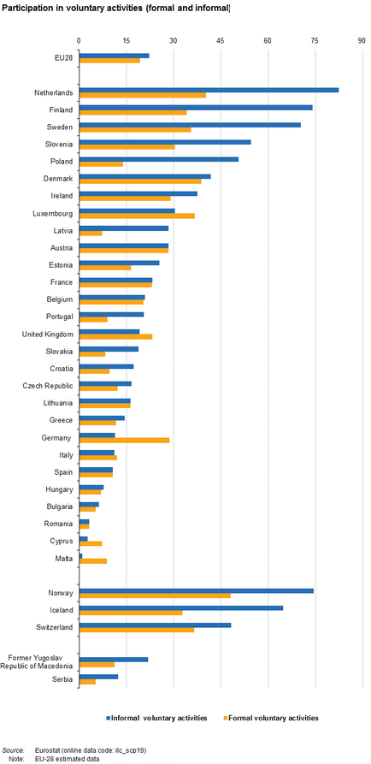
FREE, RESPONSIBLE & ACTIVE CITIZEN
1.4. Ο εθελοντισμός

