Slide 1
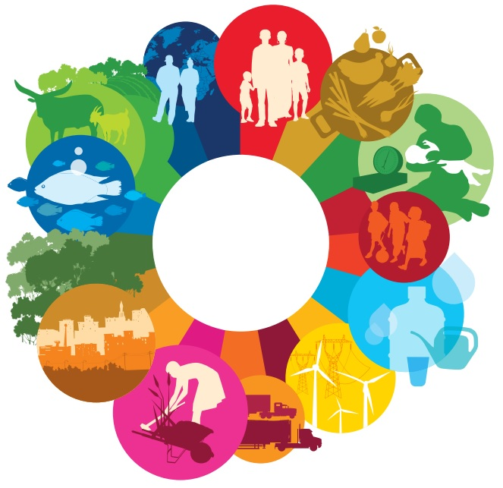
Sustainable diet for a healthy diet!
1.1. Definition of sustainability
● The term sustainability denotes the harmonious coexistence of people and their environment.
What is sustainability?
● Nutrition plays a direct role in this context, because our food choices can affect the environment. At the same time, the environment influences our choices and significantly determines the availability and quality of food.
● It presupposes the exploitation of natural resources at such a rate as to avoid environmental degradation and combines human actions and choices in the present, with the aim of preserving life in the future.

Slide 2
Sustainable diet for a healthy planet!
1.2. What is sustainable diet?
What is sustainable diet?
→The need to meet the basic nutritional requirements of the planet reduced the attention that should be given to the sustainability of the environment and the adoption of more ecological nutritional models.
→ A sustainable diet is defined as a diet that contributes to the achievement of consumer health, while protecting natural resources.
→ At the same time, a large proportion of the world's population lives in conditions of food insecurity, including older adults and young people.
→ Despite technological innovations and advances in science, agriculture, livestock and fisheries have not yet been able to meet the nutritional requirements of the entire planet.
→ According to the United Nations, in 2020, 720 million people were living in starvation and 928 million were severely malnourished, and that number is expected to increase significantly in the post-COVID-19 era.

Slide 3
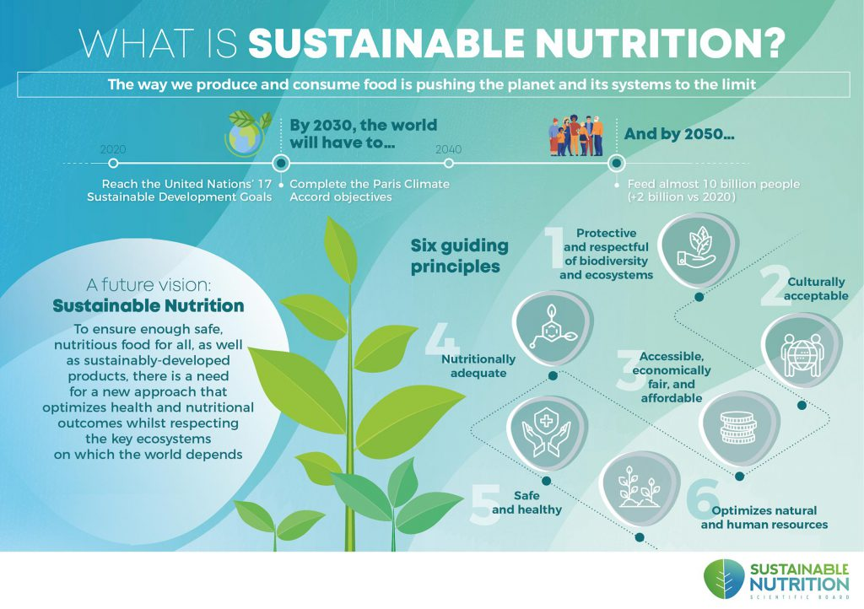
Sustainable diet for a healthy planet!
1.2. What is sustainable nutrition?

Slide 4
Sustainable diet for a healthy planet!
1.3. Goals of sustainable food systems
Prevention of malnutrition
Ensuring physical & mental well-being at all stages of life for present and future generations
Achieving everyone’s optimal growth
Reducing the prevalence of diet-related diseases
Support and conservation of biodiversity
According to the Food and Agriculture Organization of the United Nations (FAO), the goals of sustainable food systems are:

Slide 5
Sustainable diet for a healthy planet!
2.1. Why should we adopt a sustainable diet?
2.1.1. State of the planet
The environmental impact of food production is not negligible. It is estimated that food production and waste account for 1/3 of the man-made greenhouse gases (GHG) released worldwide.
→ Fisheries, agriculture and livestock together generate 1/4 of GHG emissions, while using about 70% of the resources of fresh, running water, much energy and land.
→ Securing the planet's resources presupposes significant changes in our diet, leading to the adoption of a greener system (with an emphasis on plant-based foods), reducing food waste, improving the production chain and adopting more environmentally friendly daily practices.
→ The use of antibiotics, antiparasitics, fertilizers and other chemicals to improve production also leads to water and soil contamination, biodiversity reduction and soil erosion.

Slide 6
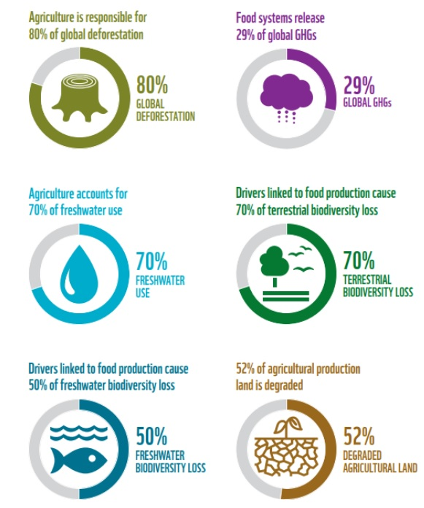
Sustainable diet for a healthy planet!
2.1. Why should we adopt a sustainable diet?
2.1.1. State of the planet

Slide 7
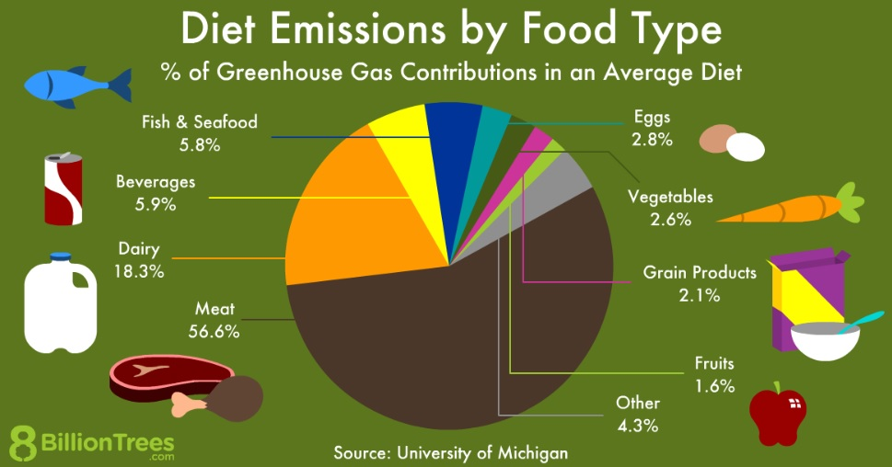
Sustainable diet for a healthy planet!
2.1. Why should we adopt a sustainable diet?
2.1.1. State of the planet

Slide 8
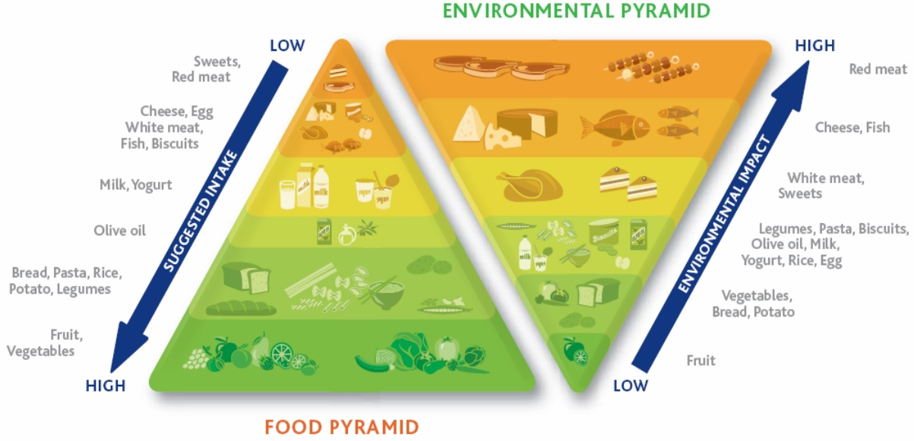
Sustainable diet for a healthy planet!
2.1. Why should we adopt a sustainable diet?
2.1.1. State of the planet

Slide 9
Sustainable diet for a healthy planet!
2.1. Why should we adopt a sustainable diet?
2.1.2. The state of our health
→ Therefore, the proposal to adopt a diet that promotes health while protecting environmental resources is the ideal solution to replace unhealthy and environmentally harmful eating habits. In other words, it is a win-win solution, with two-fold benefits for the environment and our health.
→ Dietary changes can reduce GHG emissions by 30%, wildlife extinction by 46%, land use by 41% and premature mortality by 20%.
→ Inadequate consumption of vegetables, fruits, legumes, whole grains, fish, & dairy as well as increased intake of sodium (salt), sugar and processed foods are associated with obesity, cardiovascular disease, hypertension and diabetes.
→ It is estimated that about 3 billion of the world's population can not ensure a healthy diet.
→ Although food systems and dietary standards have the potential to promote human health and support environmental sustainability, they currently appear to pose a threat to both our health and the environment.

Slide 10
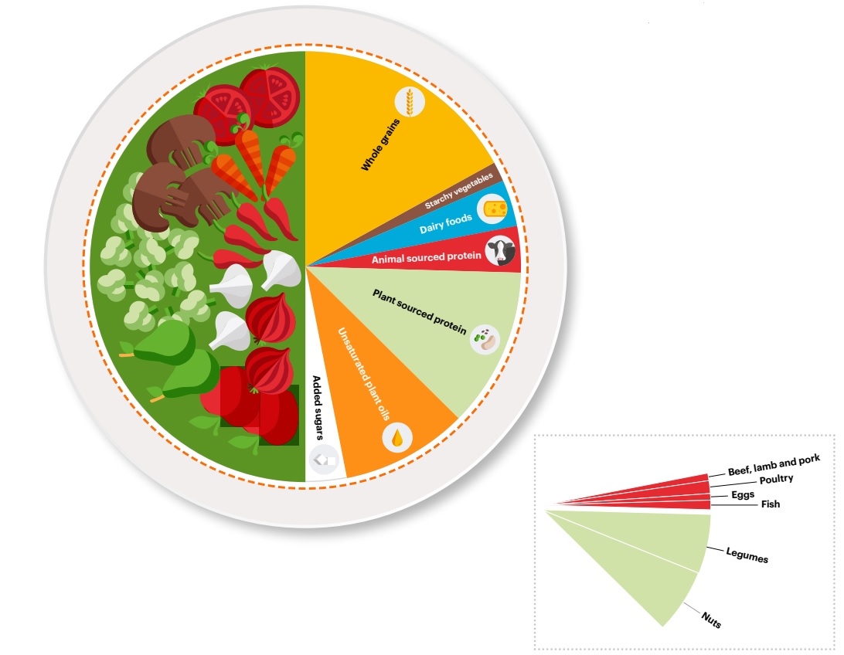
Sustainable diet for a healthy planet!
2.1. Why should we adopt a sustainable diet?
2.1.2. The state of our health
The planetary health plate

