Slide 1
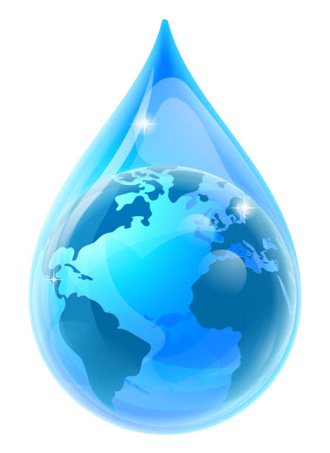
Exploring the great waterways of the world
Rivers and lakes of the world
1. Pollution of lakes and rivers
1.1. Causes of pollution
Water pollution is any change in the physical, chemical and biological parameters of water, due to the presence of substances in it, in an amount that exceeds normal limits. This change can have a negative impact on humans, other animal or plant organisms and generally upset the balance of ecosystems on a small or large geographical scale.
Sewage Wastewater of cities and settlements coming from homes and various other activities (schools & universities, public enterprises, workplaces, tourist units, hospitals, laboratories and medical centres, craft industry, etc.)
Acid rain, due to air pollution or precipitation of gaseous pollutants through rain, snow, wind or due to gravity.
Agricultural activities Agricultural holding carries pesticides and fertilizers used in the cultivated areas, through irrigation. Similarly, livestock wastewater from large or smaller livestock farms.
Industrial waste Industrial waste, which may be municipal wastewater and contain hazardous or toxic elements.

Slide 2
Exploring the great waterways of the world
Rivers and lakes of the world
1.6. Pollution of lakes and rivers
1.2. Effects of pollution
Lack of drinking water
Biodiversity loss
Local climate change
Spread of diseases
Contaminants in the food chain

Slide 3
Exploring the great waterways of the world
Rivers and lakes of the world
1.6. Pollution of lakes and rivers
1.6.3. Sustainable solutions to reduce pollution
Individual action
Purchase of environmentally friendly products
Rational use of water and reuse
Action at local / state level
Measures to limit the use of fertilizers / pesticides
Biological urban wastewater treatment
Strict environmental legislation / fines for violators
Recycling
Participation in environmental actions
Anti-pollution technologies

Slide 4
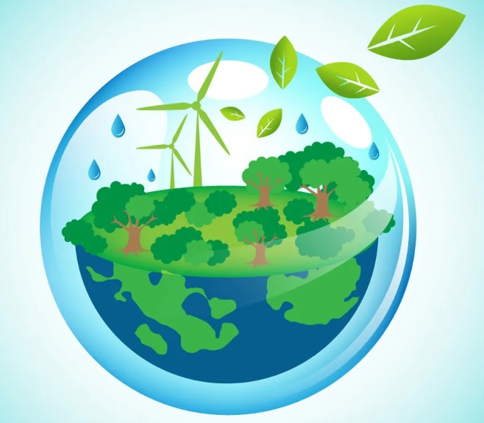
Exploring the great waterways of the world
Rivers and lakes of the world
No water, no life. No blue, no green.

