Slide 1


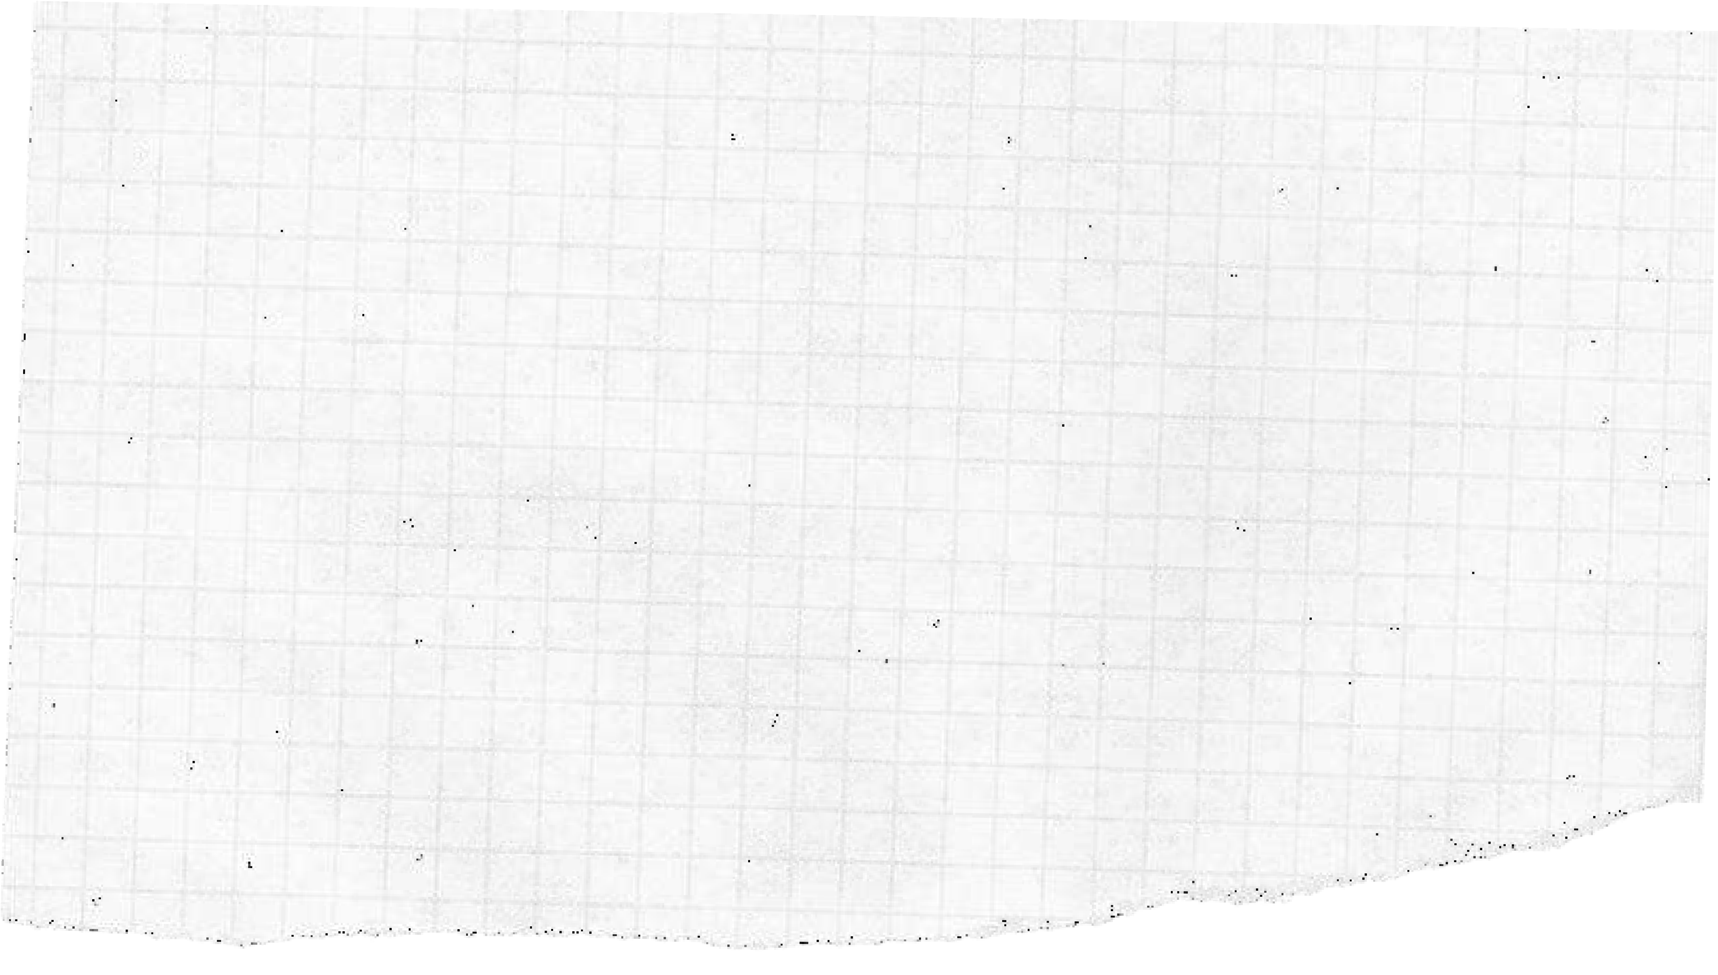
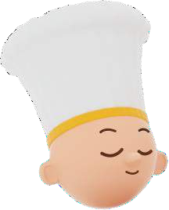

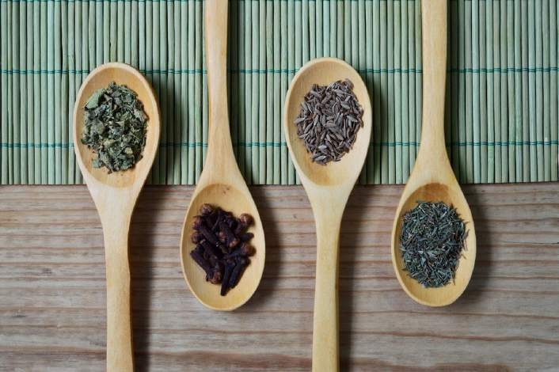
MATH-CHEF
YOU’RE INVITED
TO LUNCH!

Slide 2
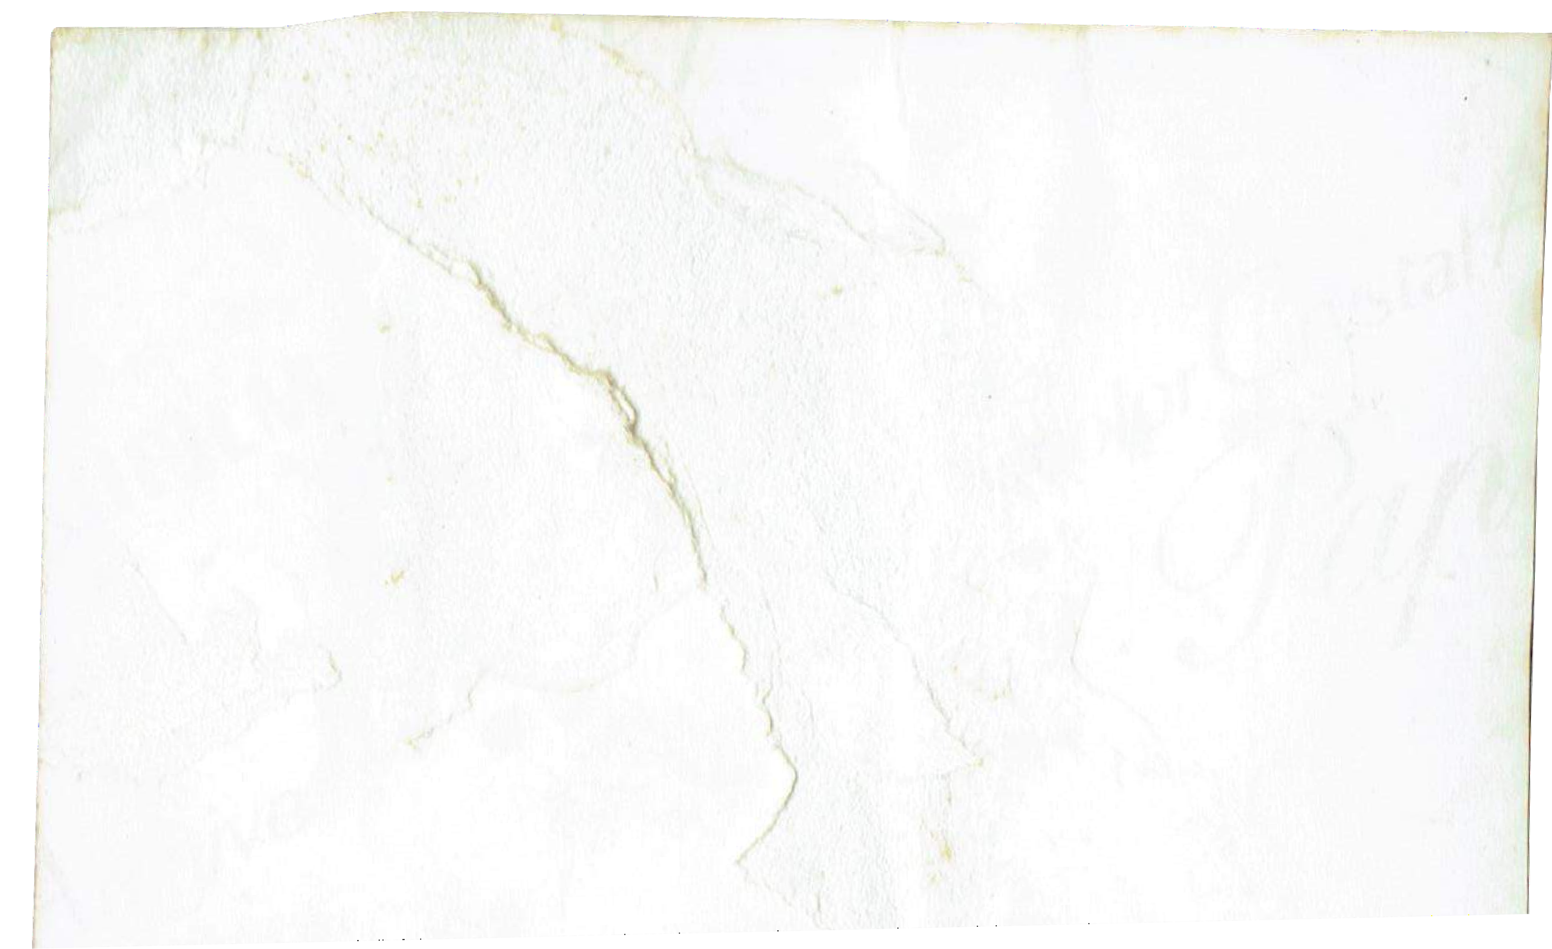
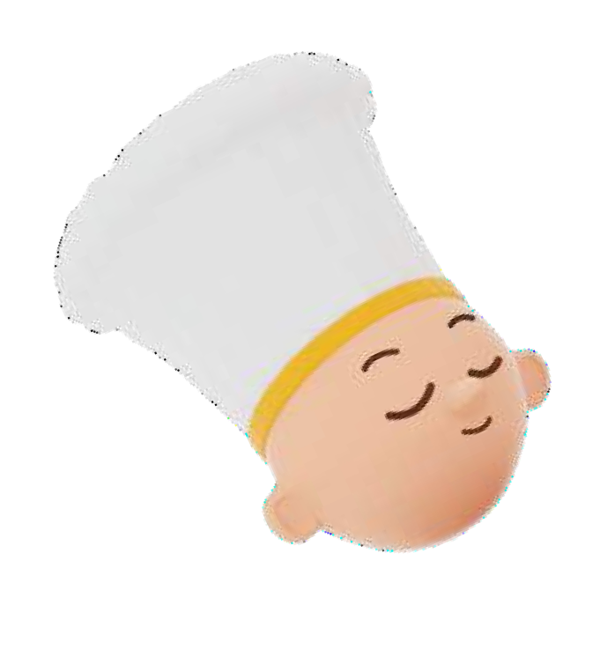
You are participating in the show Math-Chef and you have to carry out 3 tasks to get to the finale.
Task 1: Omelettes. Answering questions. Task 2: Our recipes.
Task 3: Recalculation of a recipe.
Good luck!

Slide 3
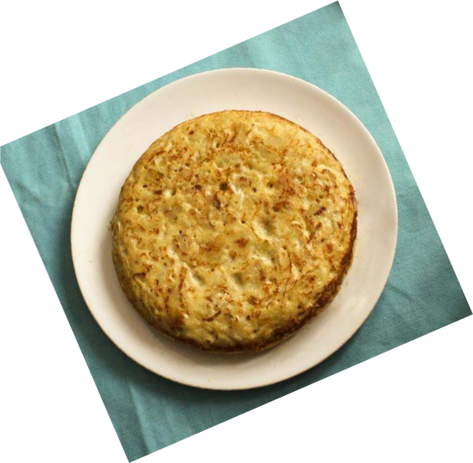
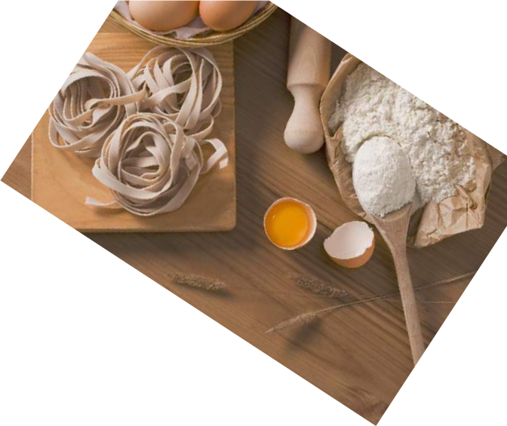

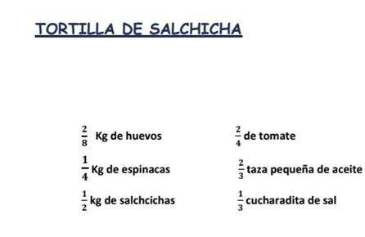
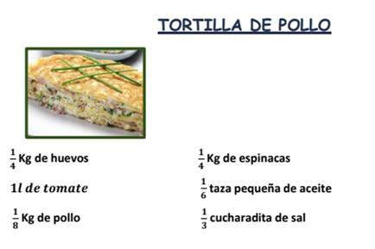
Task 1: Omelettes
To do this task, you should look at the two recipes below and answer these questions:
If I had oil, which recipe would be the most suitable?
Do I need any more chicken or sausages?
If I bought a lot of eggs, which recipe would I spend more eggs on?
SAUSAGE OMELETTE
CHICKEN OMELETTE
2/8 kg eggs
¼ kg spinach
½ kg sausages
2/4 tomatoes
⅔ small cup of oil
⅓ teaspoon of salt
1/4 kg eggs
1L tomato
⅛ kg chicken
¼ spinach
⅙ small cup of oil
⅓ teaspoon of salt

Slide 4
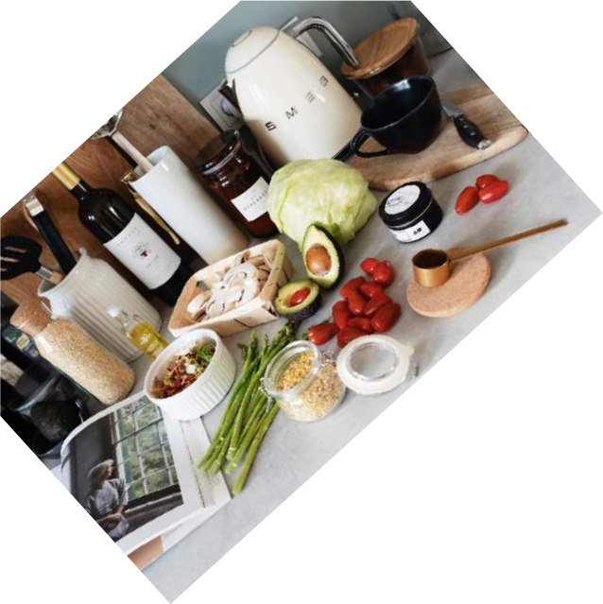

Task 2: Our recipes
1) Each group will have to present four recipes of their choice, one per team member. The only condition is that their ingredient quantities are fully specified or stated in decimals. You can ask your parents, look them up on the Internet or a cookbook.
To complete this task,you will have to write a document with
4 recipes. You will have
to calculate the cost of one of them and give it to the Head Chef.
2) Once your 4 recipes are ready, you will choose one and calculate its cost. To do so, you will need to check out the real price of the used ingredients and make a chart where you will specify the price of each ingredient, the price of the used quantities as well as the total price of the whole recipe.
3) After that, a comparison of the cost of the recipe in point 2 will be made. You will have to take into account the price of the ingredients as if bought at 2 different supermarkets. The actual prices of the ingredients may be looked up in the supermarkets' advertising magazines or on their websites. You will analyse where it would be more economical to buy the ingredients for your recipes.

Slide 5
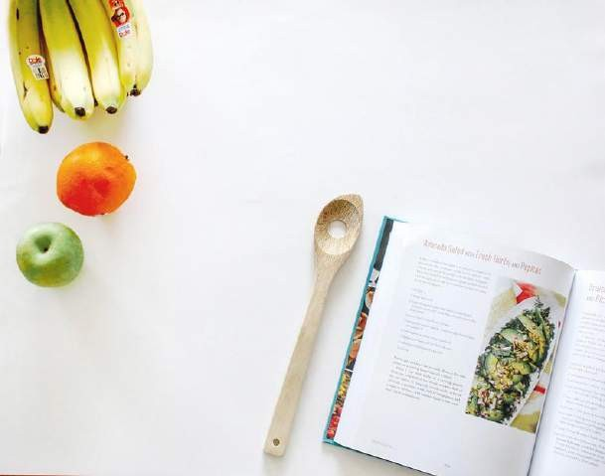
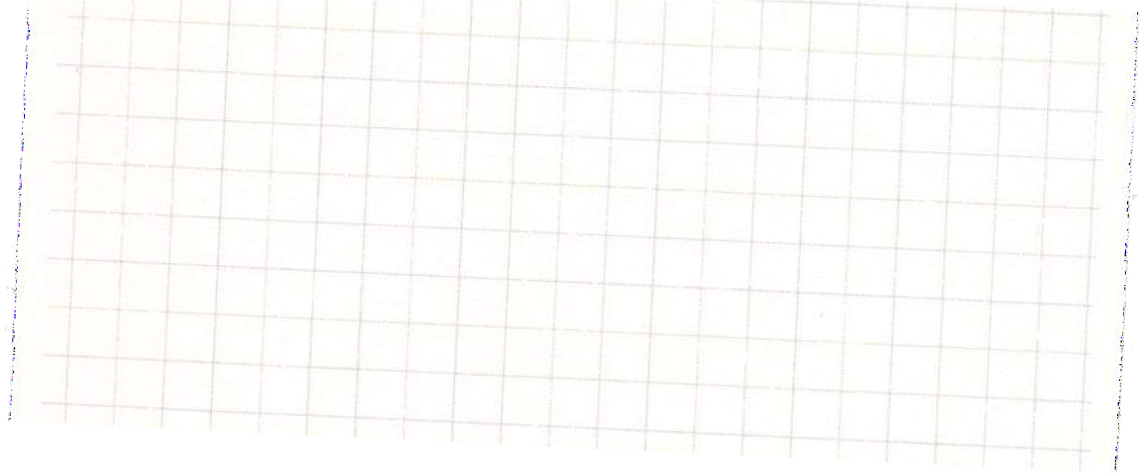

Task 3: Recalculation of a recipe
Now we will make a type of dessert called rice pudding for our classmates. We have found a recipe on a cookbook but there is a problem. It serves 4 people and there are 28 of us. Therefore, we will have to adapt the recipe for the number of fellow diners.
What shall we do? Perhaps we should make a conversion chart.
Let’s see what happens.
TO SUCCEED IN THIS TASK, YOU WILL HAVE TO PROVIDE A SOLUTION TO THE PROBLEMS ON “TASK 3” SHEET AND HAND IT IN TO THE HEAD CHEF
(teacher)
RICE PUDDING RECIPE ( 4 PEOPLE)
⮚ 100 gr rice
⮚ 750 ml semi-skimmed milk
⮚ 100 gr sugar
⮚ 4 gr ground cinnamon
⮚ 1 lemon peel
⮚ 1 cinnamon stick

