Slide 1
TYPES OF HOUSES IN EUROPE
ERASMUS PROJECT “INCLUDE”

Slide 2
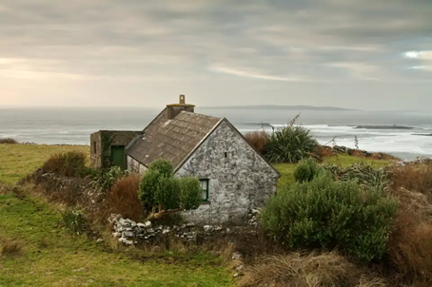
Stone Cottage – Ireland
The most common traditional home in Ireland is the stone cottage, which dates back to the 18th century. Historians believe that these stone cottages were first built as a means of replicating the larger homes of wealthier families. Locally-sourced stone was used to build these homes, brought in from a 5-mile radius by pack animals. The floors in these cottage was either fashioned of packed earth or more stone, depending on availability of materials. Stone cottage interiors are similar in that a large fireplace, or hearth, is located in the center of the house. This placement allowed a bedroom to be located behind the fireplace to take advantage of the heat source.

Slide 3
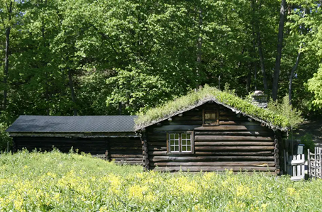
Log house - Northern Europe
Log houses, also known as log cabins, originated throughout northern Europe in Sweden, Finland, Norway, and Russia, where forests and timber were been plentiful. These homes are characterized by the exterior, which is made of logs placed horizontally and fitted in place at the corners by careful notching in the wood. The practice of building log houses dates back to Viking and Medieval times. At the beginning of the 17th century, Swedish settlers introduced this home style to North America, where it was copied by other colonists and Native American tribes.

Slide 4
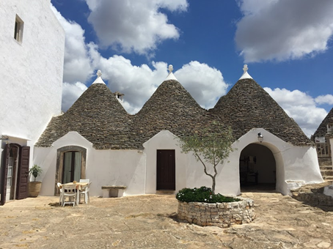
Trulli – Alberobello, Italy
The trulli, limestone dwellings found in the southern region of Puglia, are remarkable examples of drywall (mortarless) construction, a prehistoric building technique still in use in this region. The trulli are made of roughly worked limestone boulders collected from neighbouring fields. Characteristically, they feature pyramidal, domed or conical roofs built up of corbelled limestone slabs.
The walls comprise a double skin with a rubble core. A doorway and small windows pierce the walls. An internal fireplace and alcoves are recessed into the thick walls.

Slide 5
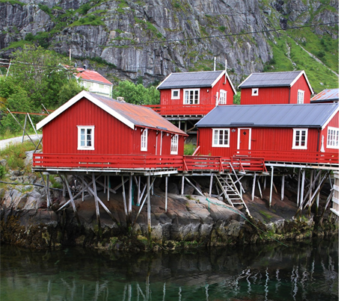
Rorbu – Norwey
Rorbu is a Norwegian traditional type of seasonal house used by fishermen, normally located in a fishing village. The buildings are costructed on land, but with the one end on poles in the water, allowing easy access to vessels. The style and term is used along the coast of Western Norway and Northern Norway, and is most common on Lofoten and northwards to eastern Finnmark. The use of rorbu for fishing has diminished and the style of housing is now largely used to rent out to tourists.

Slide 6
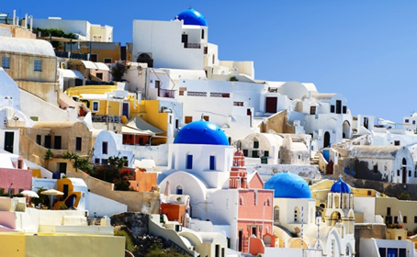
Whitewashed style, Cyclades
In the Cyclades and Dodecanese islands, closer to the old Asia Minor, properties have more of a Middle Eastern look. Think of whitewashed houses with brightly coloured domes, doors and balconies. In 1938, there was an outbreak of cholera in Greece, including the Cycladic islands. Dictator Metaxas, the ruler of Greece at the time, passed a law for all houses in the Cyclades to be whitewashed in an effort to stop its spread.
The material used for whitewashing was limestone, which was considered a powerful disinfectant, given that the use of chlorine wasn’t common yet.

Slide 7
Whitewashed style, Cyclades
But where did the blue come from?
And the blue? Several accent colours are used for contrast, blue being the most common one. the Cycladic house shutters aren’t always blue, although it tends to be one of the most common colours. If you go around the Cycladic islands, you will see shutters and other wooden surfaces painted in many different colours.
Traditionally, the fishermen would paint their homes’ shutters in whatever colour was left over after they had finished repainting their boat.

