Slide 1

Emotional eating: Do we eat what we feel?
1.1. What is emotional eating?
● Emotional eating involves the consumption of food in order to meet emotional needs instead of satisfying physical hunger.
Emotional eating
● Emotional eating is not a problem, if food is consumed as a reward and to improve somebody’s mood, on a small scale. But when food is the basic mechanism for problem management, the person is trapped in an unhealthy cycle of avoiding emotions and problems.

Slide 2
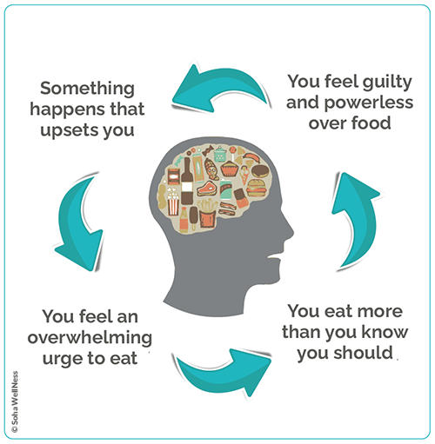
Emotional eating: Do we eat what we feel?
1.1. What is emotional eating?

Slide 3
Emotional eating: Do we eat what we feel?
1.2. Diet and emotions: a two-way relationship
Loneliness → food acts as company and consolation.
Stress → food is consumed for enjoyment / relaxation.
Sadness → food offers (short-term) joy and satisfaction.
Joy → food is part of celebrations (eg birthday).
Compassion → "I deserve this food because I had a very bad day".
Abandonment → food is always available, it is a reliable fixture in our lives.
Fear → food acts as a means of relief and as a way of reassurance.
In emotionally charged situations, food serves a variety of purposes. But the opposite can also happen: emotional overload can lead to reduced food intake..
Reward → "I deserve this food because today I had a huge success (eg promotion)".

Slide 4
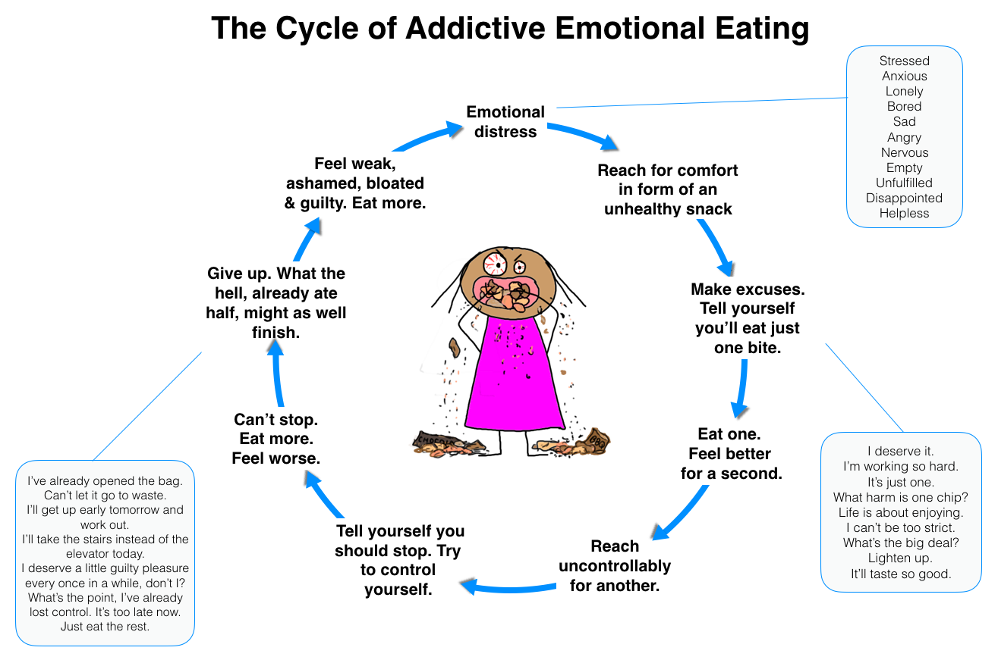
Emotional eating: Do we eat what we feel?
1.2. Diet and emotions: a two-way relationship

Slide 5
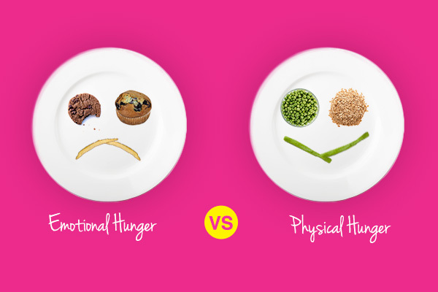
Emotional eating: Do we eat what we feel?
1.3. Emotional or physical hunger?
People who tend to eat emotionally cannot differentiate hunger from their psychological state, which is accompanied by negative emotions. They usually resort to over-consumption of foods rich in sugar and fat, as a result of which they offer their body only a temporary emotional relief from the problem that really concerns them.

Slide 6
Emotional eating: Do we eat what we feel?
1.3. Emotional or physical hunger?
Physical hunger
It appears gradually.
Emotional hunger
It appears suddenly.
When satiety occurs, the brain tells us not to consume anymore.
There is a feeling that we are never full.
It is accompanied by a feeling of guilt.
You do not feel guilty after a meal.
There is a sense of food consumption from all food groups.
Selection of mainly unhealthy foods, rich in fat, sugar and salt.
It is conscious and there is awareness of what we are eating at any given time.
There is no control over the amount of food we consume.
It is directly related to the emotions we experience and it is a need of the brain.
Urgent need for food.
It is a need of the stomach.
There is patience. We think we should eat, but not right NOW.

Slide 7
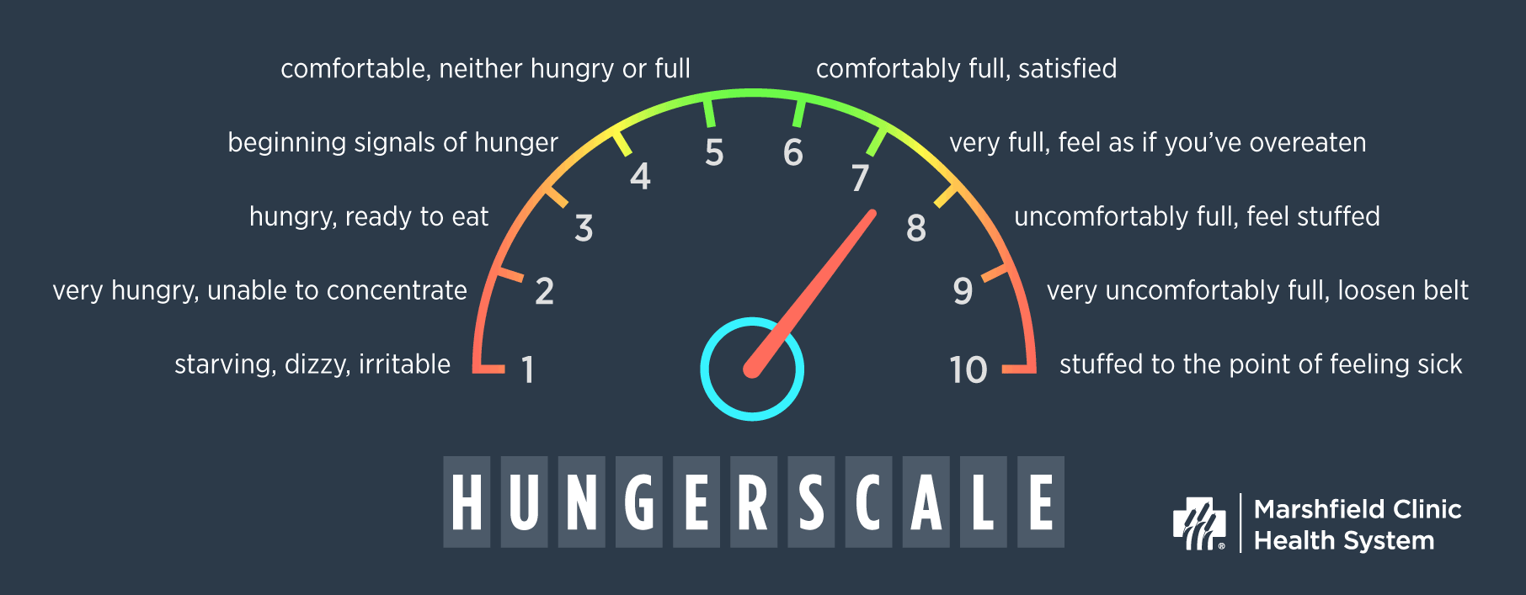
Emotional eating: Do we eat what we feel?
1.3. Emotional or physical hunger?

Slide 8
Emotional eating: Do we eat what we feel?
1.4. Ways to deal with emotional eating
→ To train to control the urge to eat, e.g. by postponing food for 5 minutes, until it relaxes.
→ To write down the foods you eat in one day and for what reasons (emotional eating food journal): how you feel, what has preceded, what physical stimuli there are.
→ To follow a basic self-care program, which includes healthy eating, exercise and sleep.
→ To apply alternative methods of managing emotions e.g. to go for a walk with a friend when you are not feeling well, instead of resorting to food.

Slide 9
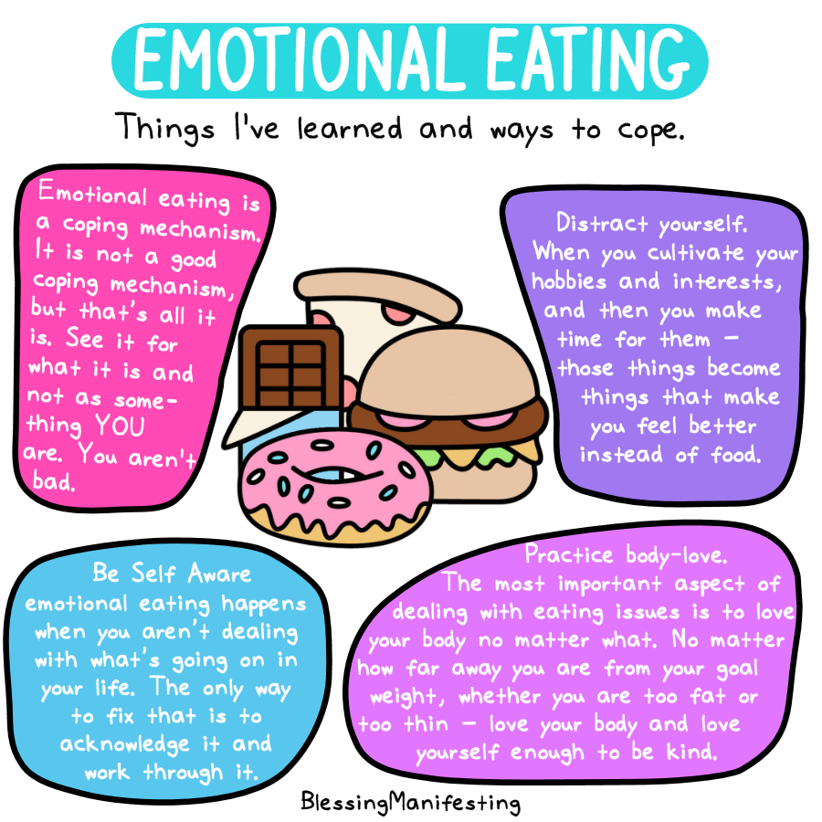
Emotional eating: Do we eat what we feel?
1.4. Ways to deal with emotional eating

