Slide 1

Emotional eating: Do we eat what we feel?
2.1. Emotional eating and eating disorders
A person's intense anxiety about his weight and his excessive preoccupation with food, are the characteristics that indicate the onset of a disturbed eating behaviour and can lead to an eating disorder over time.
Anyone can develop an eating disorder, regardless of age, gender or educational level. However, young women are more vulnerable, especially between the ages of 15-25.
The main types of eating disorders are anorexia nervosa, bulimia nervosa and binge eating.
Psychogenic eating disorders constitute a complex condition where disordered eating habits, as well as psychological difficulties, need to be treated.

Slide 2
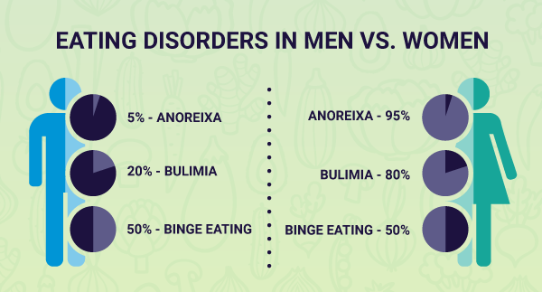
Emotional eating: Do we eat what we feel?
2.1. Emotional eating and eating disorders

Slide 3
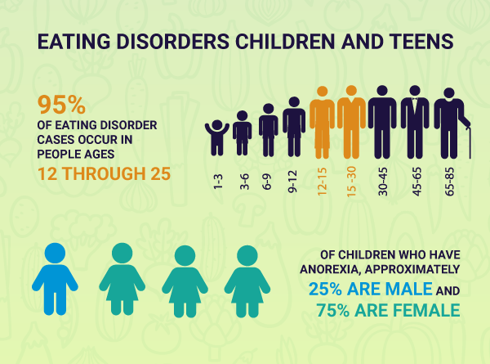
Emotional eating: Do we eat what we feel?
2.1. Emotional eating and eating disorders

Slide 4
Emotional eating: Do we eat what we feel?
2.2. Factors contributing to eating disorders
Factors that contribute to the occurrence of eating disorders
Genetic predisposition
Socio-economic & cultural factors → e.g. social pressure that gives value to the acquisition of the "perfect body", evaluation of individuals based on their appearance and not based on their abilities, beauty standards, etc.
Biological factors → In some people with eating disorders, certain biochemical parameters of the brain that control hunger, appetite, and digestion are unstable.
Psychological factors / Personality → Low self-esteem, difficulty in expressing emotions, depression, anxiety, anger or loneliness, feeling of inadequacy, strains in interpersonal relationships, etc.

Slide 5
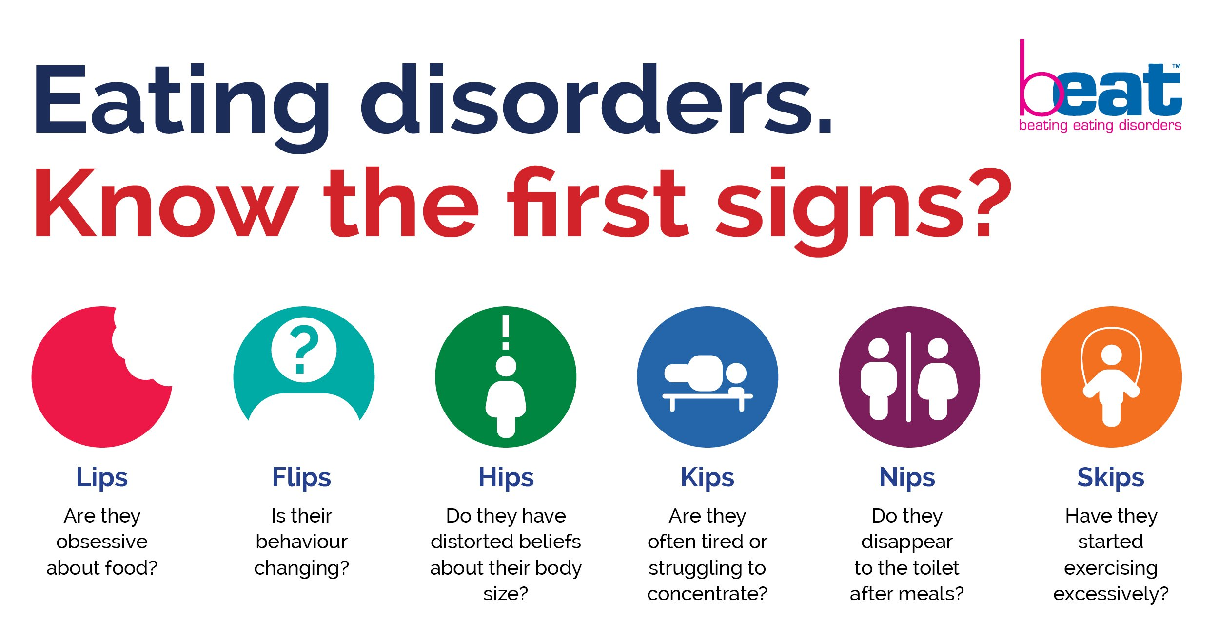
Emotional eating: Do we eat what we feel?
2.3. Signs and symptoms of eating disorders

Slide 6
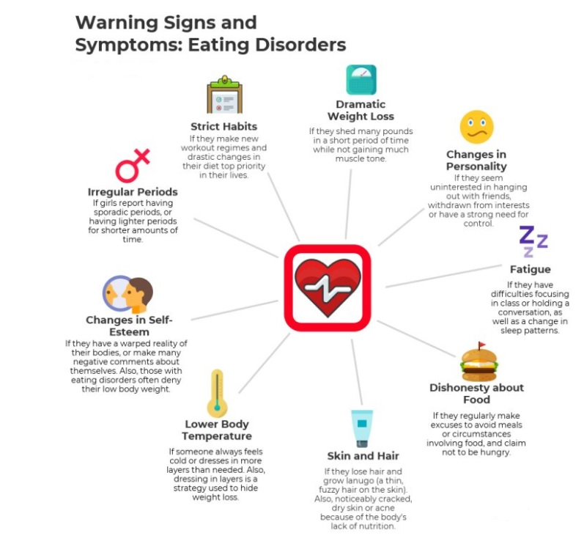
Emotional eating: Do we eat what we feel?
2.3. Signs and symptoms of eating disorders

Slide 7
Emotional eating: Do we eat what we feel?
2.4. Anorexia nervosa, bulimia nervosa & binge eating
Anorexia nervosa
→ An eating disorder which is characterized by voluntary restriction of food intake and the individual’s refusal to maintain the minimum weight, while having a distorted image of herself/himself.
→ It is a serious mental illness with high rates of morbidity and mortality.
Bulimia nervosa
→ An eating disorder which involves recurrent episodes, where large amounts of food are consumed, in a short period of time.
→ During the episodes, the person feels out of control, and is then overwhelmed with depression and guilt.
→ The episodes are followed by corrective (compensatory) behaviours in order to get rid of unnecessary calories. These include vomiting, laxative abuse, strict diet / fasting and excessive exercise.
Binge eating
→ An eating disorder characterized by excessive consumption of food at a time (in about 2 hours), which is greater than what a person would generally consume, within the same time period and under the same conditions.
→ These episodes are repeated and during them the person feels a sense of loss of control.
→ However, no compensatory action is taken, of laxative type or not, i.e. the person does not do anything to "correct" the previous act.

Slide 8
Emotional eating: Do we eat what we feel?
2.4. Anorexia nervosa, bulimia nervosa & binge eating
2.4.1. Diagnostic criteria
Anorexia
Nervosa
Bulimia
Nervosa
Refusal to maintain body weight at or above the level of the individual’s minimum normal weight for his age and height.
Intense fear of gaining weight or becoming overweight, even if weight is below normal.
Binge
Eating
Wrong perception of body weight or shape, excessive effect of weight or body shape on self-assessment, or denial of the severity of low body weight.
Recurrent episodes of compulsive eating characterized by: a) food intake at a certain time period, which is greater than normally expected at a certain time period or under certain conditions, and b) lack of ability to control food intake.
Repeated laxative-type behaviours aimed at avoiding weight gain: inducing vomiting, use of laxatives, diuretics, etc., fasting, or excessive physical exercise. Laxative behaviours or compulsive eating episodes occur on average once a week for 3 months.
A binge eating episode is characterized by: a) eating, at a given time period, an amount of food that is greater than what other people would be consuming at that time period and under the same conditions; and b) lack of control over food during the episode and c) the episodes occur approximately at least once a week for three months..
The episodes are related to three or more of the following: 1) the person eats much faster than normal, 2) eats until the unpleasant feeling of fullness appears, 3) eats large amounts of food without feeling really hungry, 4) eats without company because of feeling ashamed of how much she/he eats and 5) feels disgusted with herself/himself, melancholic or guilty after the episode..
The person feels intense discomfort about the binge eating episode.

Slide 9
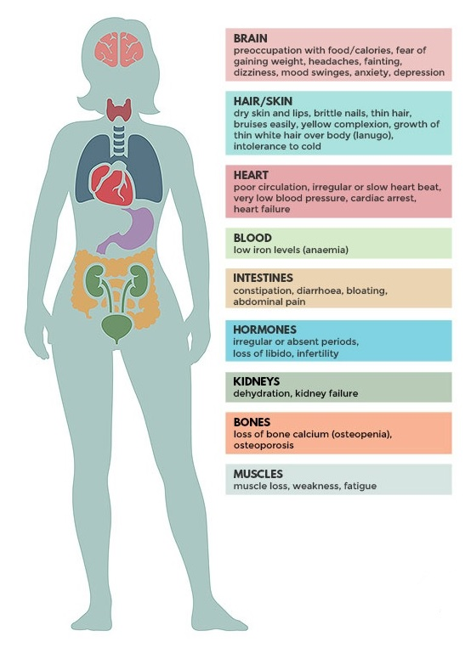
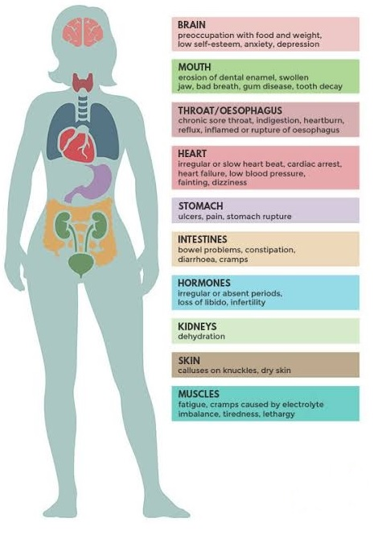
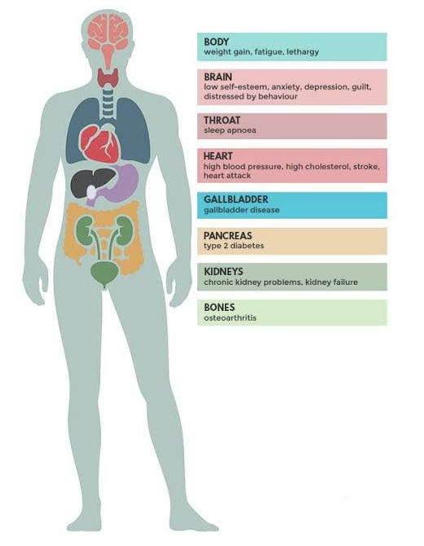
Emotional eating: Do we eat what we feel?
2.4. Anorexia nervosa, bulimia nervosa & binge eating
2.4.2. Consequences
Anorexia Nervosa
Bulimia Nervosa
Binge Eating

Slide 10
Emotional eating: Do we eat what we feel?
2.5. How can I help someone with an eating disorder?
What I should do ….
→ Choose a good time to talk to her / him when there will be no other obligations. Be calm, cool and above all do not choose to have this conversation after a fight or a typical argument!
→ Learn as much as you can about eating disorders e.g. talk to a specialist and ask how you can handle the issue.
→ Explain your concerns. Do not get yourself into the process of criticizing the person. Refer to specific behaviours and situations that you have observed and explain why they concern you. Remember that your goal is not to offer immediate solutions, but to express your concern for the person's health, how much you love them and how much you want to help them.
→ Patience and support. Do not give up if the person gets angry or refuses to talk about it again. She/he may think about what you said and gradually admit that she/he really has a problem and needs help. Let him know that the only reason you are talking to her/him is because you care, you believe in him / her and you will be there whenever needed.

Slide 11
Emotional eating: Do we eat what we feel?
2.5. How can I help someone with an eating disorder?
→ Avoid comments about appearance or weight. People with an eating disorder are already overly concerned with their bodies. Even reassuring them that they are not overweight or that they are 'fine' does not help because it further enhances their preoccupation with wanting to lose weight.
What I shouldn’t do ….
→ Avoid criticism / accusations, especially in front of others. Phrases like: 'Try to eat more', 'You hurt yourself for no reason', have no practical benefit. Instead, they make things worse and the person feels that she/he has no support.

Slide 12
Emotional eating: Do we eat what we feel?
2.5. How can I help someone with an eating disorder?
Eating disorders are treated by a multidisciplinary team of health professionals (eg clinical dietitian, clinical psychologist, etc.) and includes:
→ Nutrition education, so that the person regains normal eating habits and normal weight.
→ Hospitalization for people with severe weight loss and other serious organic problems.
→ Psychotherapeutic techniques in the provision of help to individuals so that they can explore unconscious parts of their personality and past relationships, which account for the development of their problematic attitude and behaviour.
→ Involvement of the whole family in the treatment process.

