Slide 1
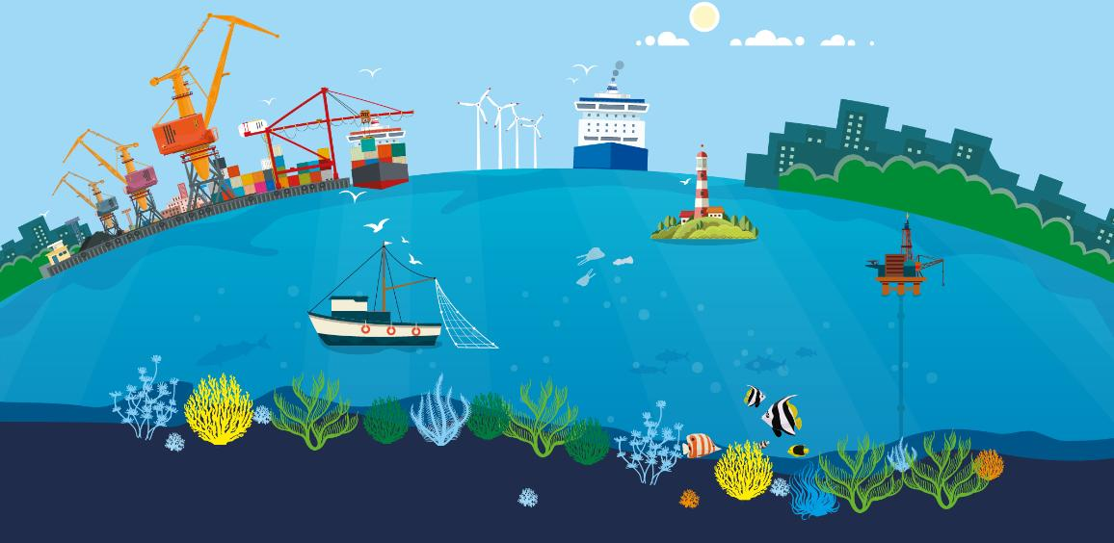
Planet Ocean: Why is the Blue Economy so Important?
Healthy oceans constitute a prerequisite for a thriving blue economy. Pollution, overfishing and the destruction of natural habitats, combined with the effects of the climate crisis, threaten the marine biodiversity which the blue economy depends on. We need to change course and develop a sustainable blue economy, in which environmental protection goes hand in hand with economic activities.

Slide 2
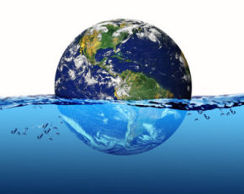
Planet Ocean: Why is the Blue Economy so Important?
1.1. Oceans of the world
Oceans
The distribution of salt water is not the same all over the Earth. Most of the Earth is covered by oceans, except that in the northern hemisphere the water covers 60% of its surface, while in the southern hemisphere 80%.
The largest ocean in area and depth is the Pacific. It is as large as all the other oceans together. The deepest point of the Pacific Ocean is the Mariana Trench (it reaches about 11,000 m).
Geographers divide the world ocean into five smaller parts: the Pacific, the Atlantic, the Indian, the Arctic, and the Southern Ocean.
Oceans are connected to each other. In fact, all of the planet's salty water is a single mass, called the “world ocean", which covers 70% of the planet's surface.

Slide 3
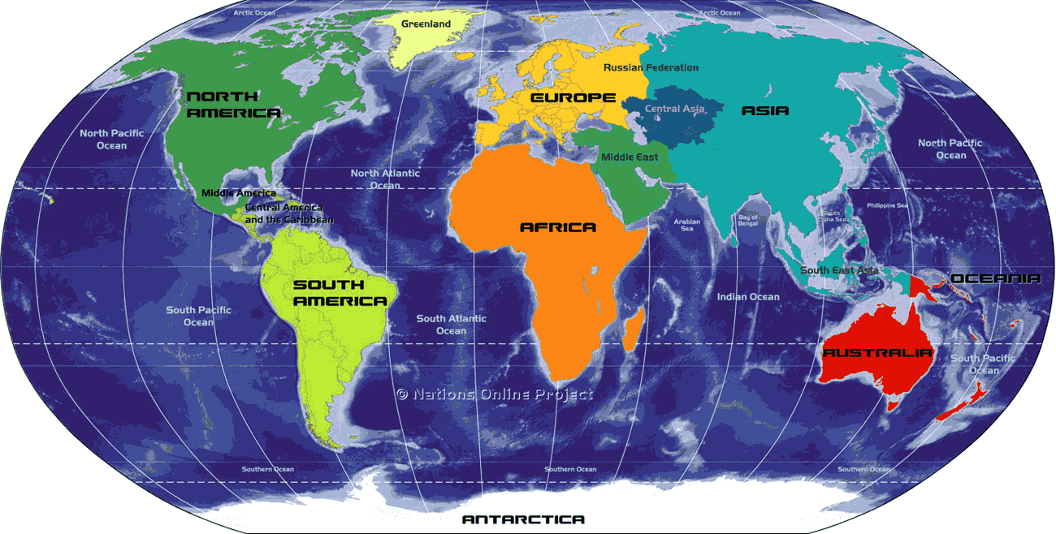
Planet Ocean: Why is the Blue Economy so Important?
1.1. Oceans of the world

Slide 4
Planet Ocean: Why is the Blue Economy so Important?
1.2. Seas of the world
Νορβηγική Θάλασσα
The seas are smaller than the oceans, are usually located between lands and are considered “branches" of an ocean.
➢ The Atlantic Ocean, besides the Arctic Sea, includes the Mediterranean, the Black Sea, the Caribbean, the North, the Norwegian, and the White Seα.
➢ The Pacific Ocean includes the Bering Sea, the Sea of Okhotsk, the Sea of Japan, the China Sea (east and south) and the Coral Sea.
➢ The Indian Ocean includes the Red Sea and the Arabian Sea.
Καραϊβική Θάλασσα

Slide 5
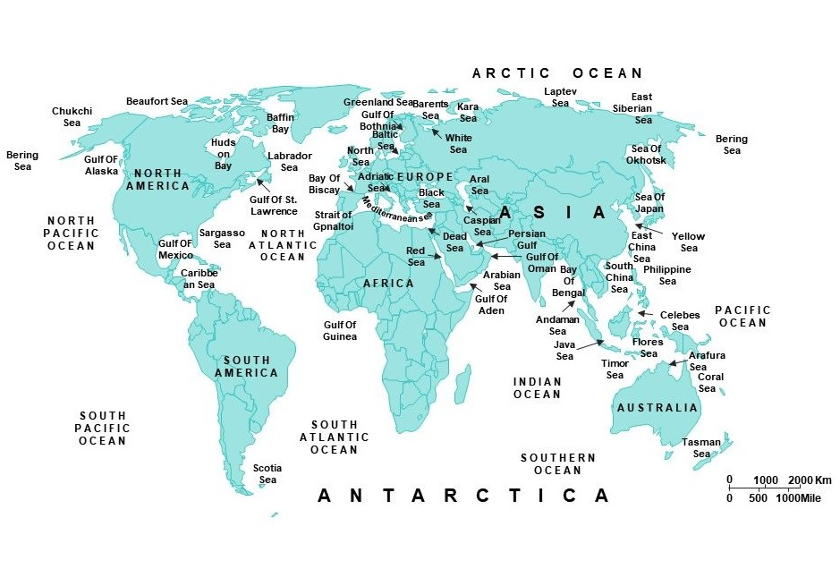
Planet Ocean: Why is the Blue Economy so Important?
1.2. Seas of the world

Slide 6
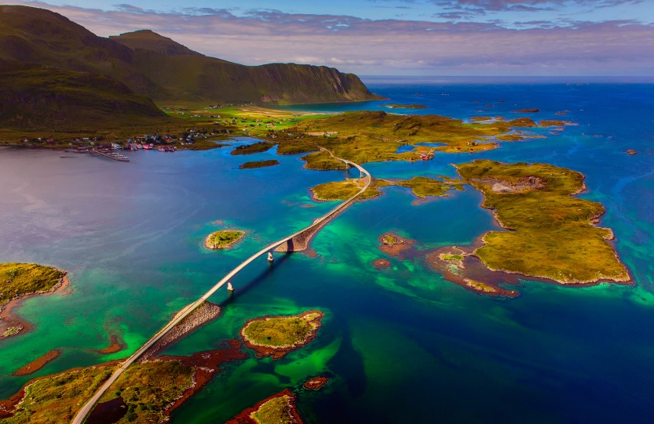
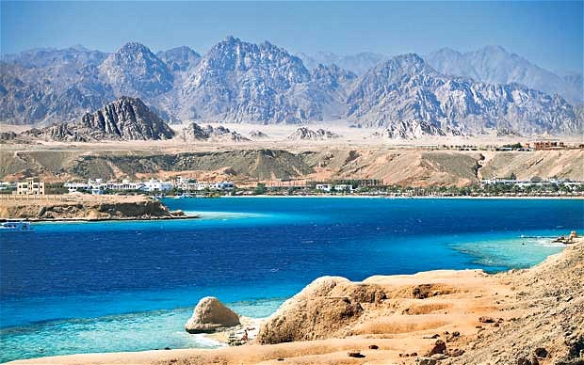
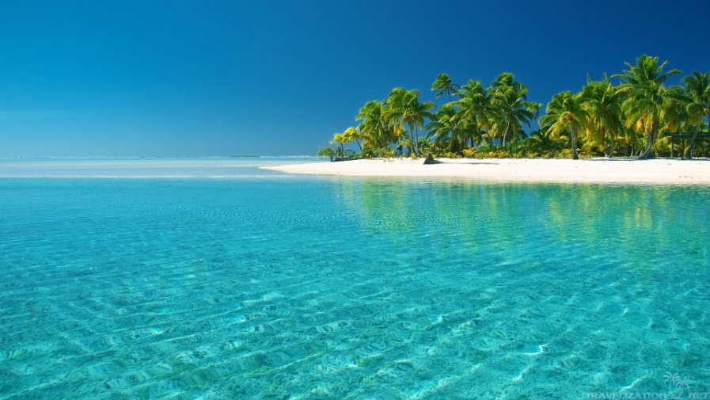
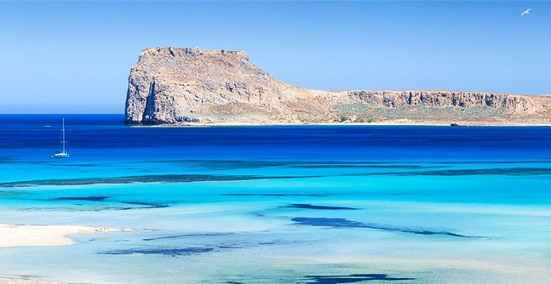
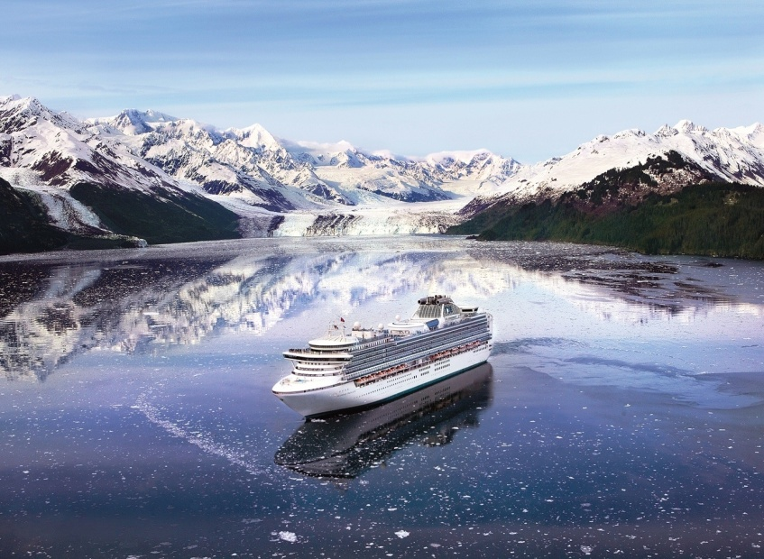
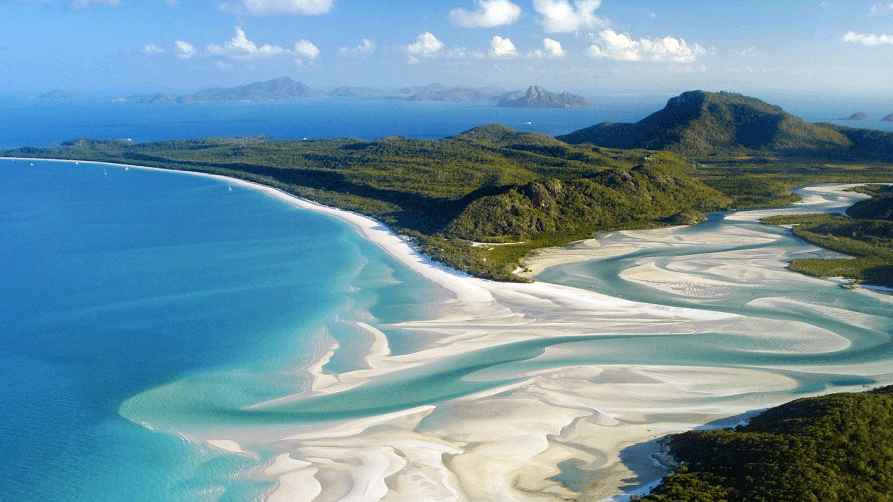
Planet Ocean: Why is the Blue Economy so Important?
1.2. Seas of the world
Norwegian Sea
Red Sea
Caribbean Sea
Mediterranean Sea
Ανατολική Σινική Θάλασσα
Bering Sea
Coral Sea

