Slide 1
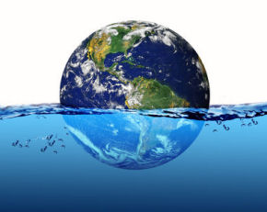
Planet Ocean: Why is the Blue Economy so Important?
1.3. What do oceans offer?
They constitute the main source of proteins for 2 billion people.
The precious drinking water comes from the world’s oceans through the hydrological cycle.
In the ocean subsoil there are significant quantities of oil and gas (over 25% of world production).
Sea currents from the oceans neutralize the uneven distribution of heat on the planet and affect global climate.
Αbout 70% of the oxygen which is present in the atmosphere comes from photosynthesis that takes place at sea (phytoplankton).
In combination with marine organisms they offer raw materials for the manufacture of medicines.
They affect several sectors of economy such as , for example, shipping, transport, trade, tourism, fishing, e.t.c.

Slide 2
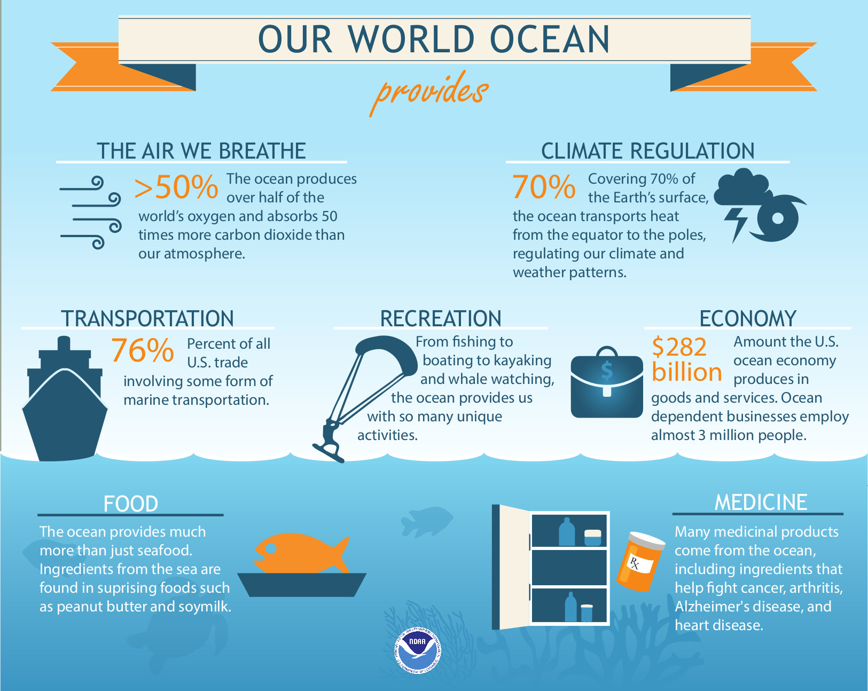
Planet Ocean: Why is the Blue Economy so Important?
1.3. What do oceans offer?

Slide 3
Planet Ocean: Why is the Blue Economy so Important?
1.4. What are oceans threatened by?
The threats that the oceans face come mainly from human activities on land and less from the sea, at a ratio of 80:20%.
Urban wastewater
Industrial wastewater
Solid waste
Air pollution
Climate change
Oil spills
Agricultural waste
Overfishing

Slide 4
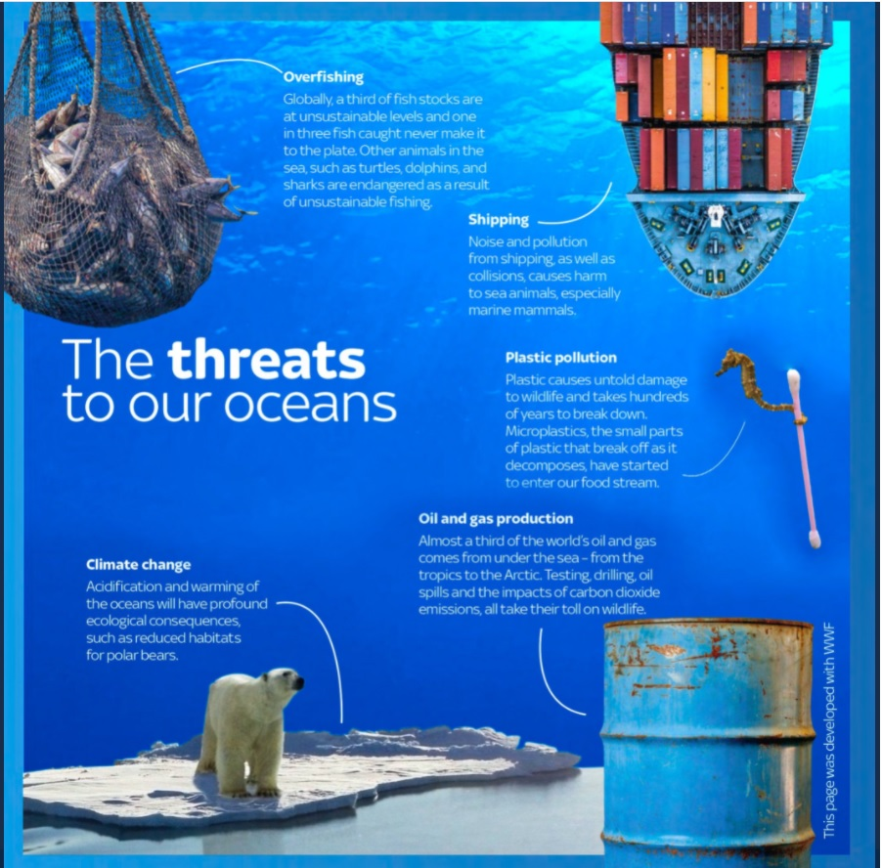
Planet Ocean: Why is the Blue Economy so Important?
1.4. What are oceans threatened by?

Slide 5
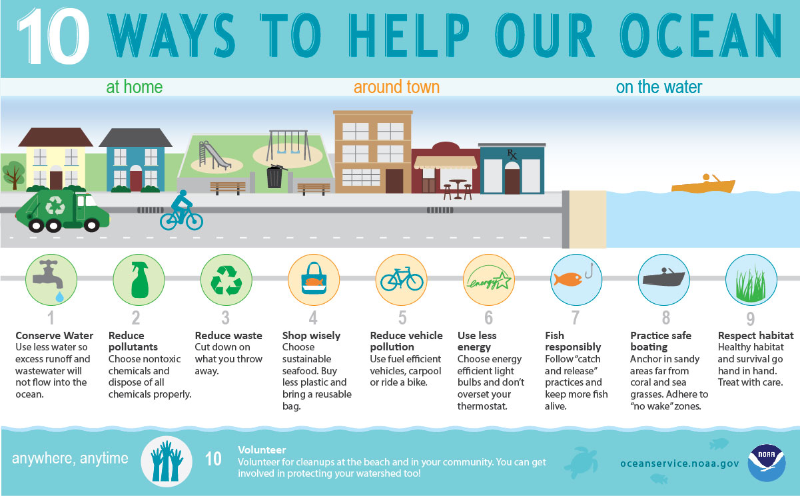
Planet Ocean: Why is the Blue Economy so Important?
1.5. How to protect oceans.

Slide 6
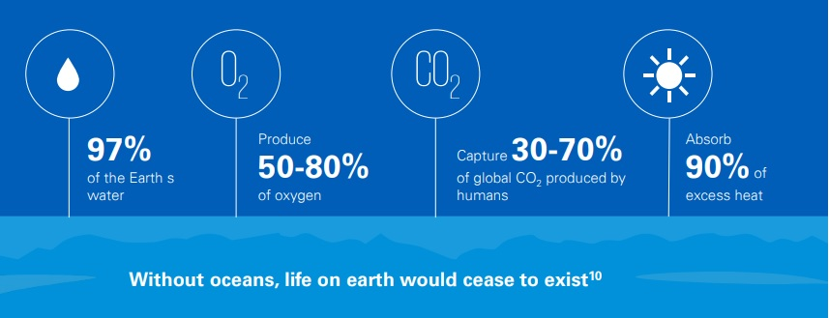
Planet Ocean: Why is the Blue Economy so Important?
1.6. The concept of Blue Economy
The blue economy refers to “the sustainable use of ocean resources to promote economic growth, social inclusion, and the preservation or improvement of livelihoods, while at the same time ensuring environmental sustainability of the oceans and coastal areas.” – The World Bank

