Slide 1
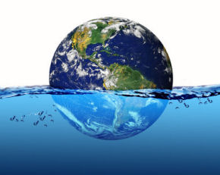
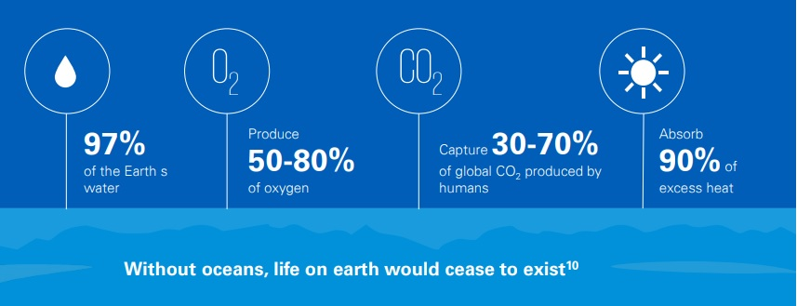
Planet Ocean: Why is the Blue Economy so Important?
1.6. The concept of Blue Economy
The blue economy refers to “the sustainable use of ocean resources to promote economic growth, social inclusion, and the preservation or improvement of livelihoods, while at the same time ensuring environmental sustainability of the oceans and coastal areas.” – The World Bank
‘Shades of Blue: what do competing interpretations of the Blue Economy mean for oceans governance?’ (2018) Australian National Centre for Ocean Resources and Security.

Slide 2
Planet Ocean: Why is the Blue Economy so Important?
1.6. The concept of Blue Economy
«How inappropriate to call this planet Earth when clearly it is Ocean»
Arthur C. Clarke.
Blue Economy
Economic development
Environmental sustainability

Slide 3
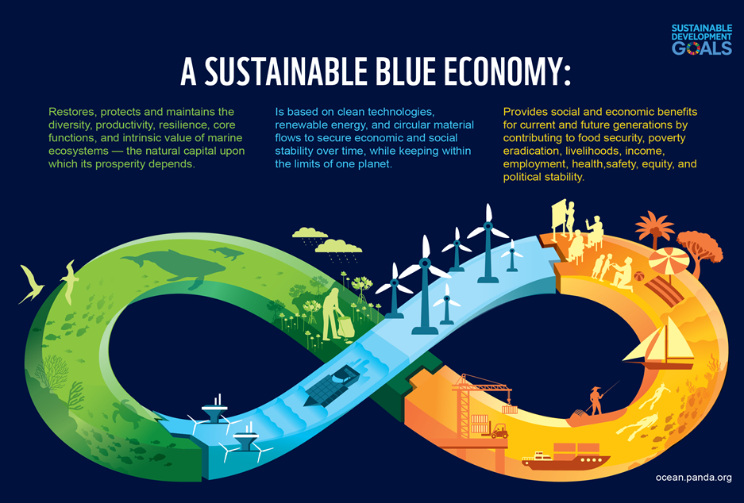
Planet Ocean: Why is the Blue Economy so Important?
1.6. The concept of Blue Economy

Slide 4
Planet Ocean: Why is the Blue Economy so Important?
1.7. Characteristics of the Blue Economy
The term "Blue Economy" includes all activities carried out in the marine/ocean environment and ecosystem.
Good use of the Blue Economy should:
→ offer economic and social benefits, not only to current generations, but also to future ones.
→ protect and preserve marine ecosystems.
→ be based on clean and sustainable technologies, producing less waste and promoting circular economy.
The degree of development of activities varies depending on the country and its exposure to the marine environment.

Slide 5
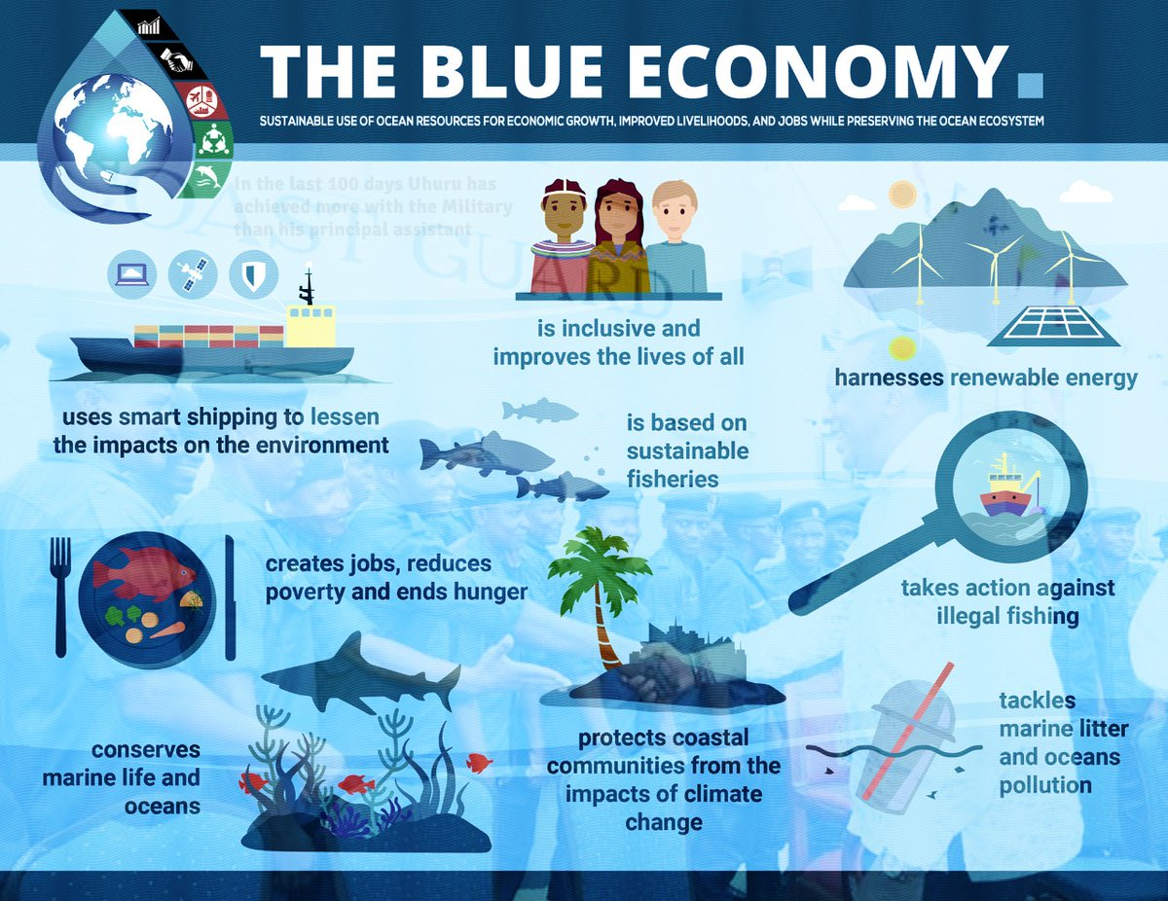
Planet Ocean: Why is the Blue Economy so Important?
1.7. Characteristics of the Blue Economy

Slide 6
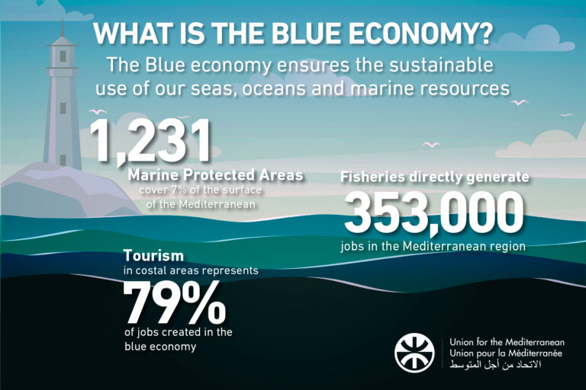
Planet Ocean: Why is the Blue Economy so Important?
1.7. Characteristics of the Blue Economy

Slide 7
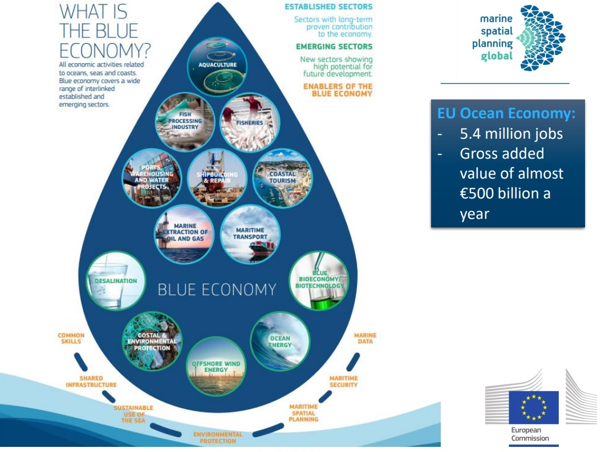
Planet Ocean: Why is the Blue Economy so Important?
1.8. Blue Economy activities

Slide 8
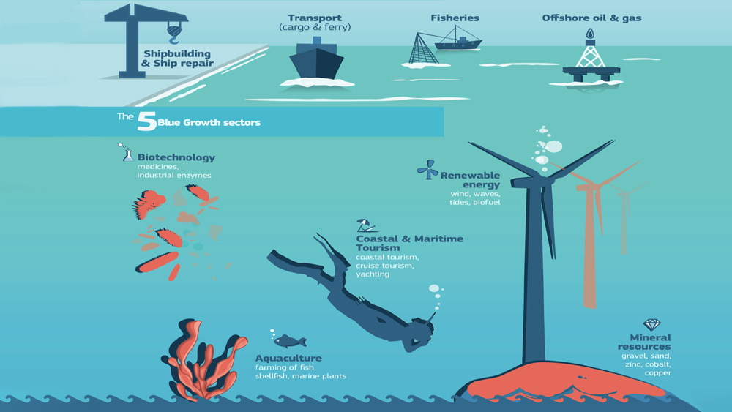
Planet Ocean: Why is the Blue Economy so Important?
1.8. Blue Economy activities

Slide 9
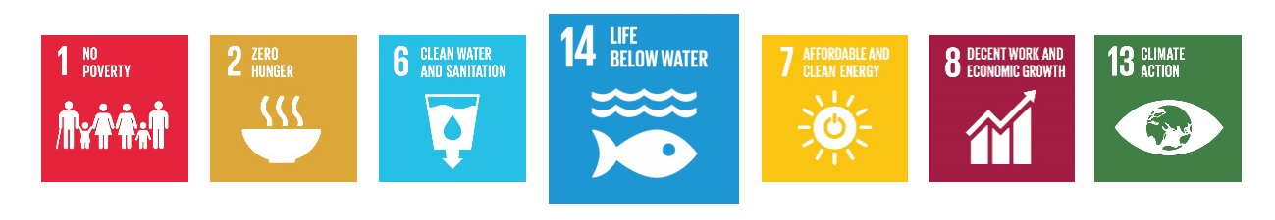
Planet Ocean: Why is the Blue Economy so Important?
1.9. No blue without green - nor green without blue
When viewing Earth from space, the overriding colour we see is blue – it is the colour that enables life on earth. Not only was terrestrial life spawned from the seas, but the oceans are responsible for our continued survival.
The ‘blue economy’ is central to the green ecosystem.
It offers both socioeconomic and environmental value, from ocean-based food and jobs, to biological and geological ‘blue’ carbon sequestration. Its centrality to global supplies of renewable energy, critical metals water and food stocks, as well as its contribution to cultural values, mobility and economic growth, underpins the success of many of the SDGs:

