Slide 1
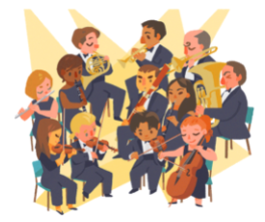
The Orchestra
for… beginners

Slide 2
Topic: The Baroque orchestra
Worksheet II
The Orchestra for… beginners
PART II

Slide 3
The orchestra…
did not always have the same size and shape. It was shaped and evolved over time according to:
The expressive needs of each era.
The expressive needs of each composer
The expressive needs of the performer; the expressive needs of the performer; the possibilities offered in each period by the technology of the instruments.

Slide 4
Baroque period (1600-1750)
It is an architectural trend that lent the term to music and painting.
Intensely rhythmic music, complex and / with many voices.
Musical forms
Opera
Oratorio
Concerto grosso

Slide 5
Baroque orchestra (1600-1750)
In Baroque music, strings play the most important part.
Baroque orchestras had from 10 to 30 players, mainly strings and harpsichord.
Wind instruments (woodwinds and brass) were used for dialogue with the strings in the melodic parts.
The woodwind and brass were used as melodic instruments but later they were mainly used to sustain the harmony.
In the baroque period, the orchestra was not standardised in size. There were large differences in size, instrumentation and playing styles - and therefore orchestral soundscapes and palettes - between the various European regions.
The 'Baroque orchestra' ranged from smaller orchestras or ensembles with one player per part, through to larger scale orchestras with many players per part.

Slide 6
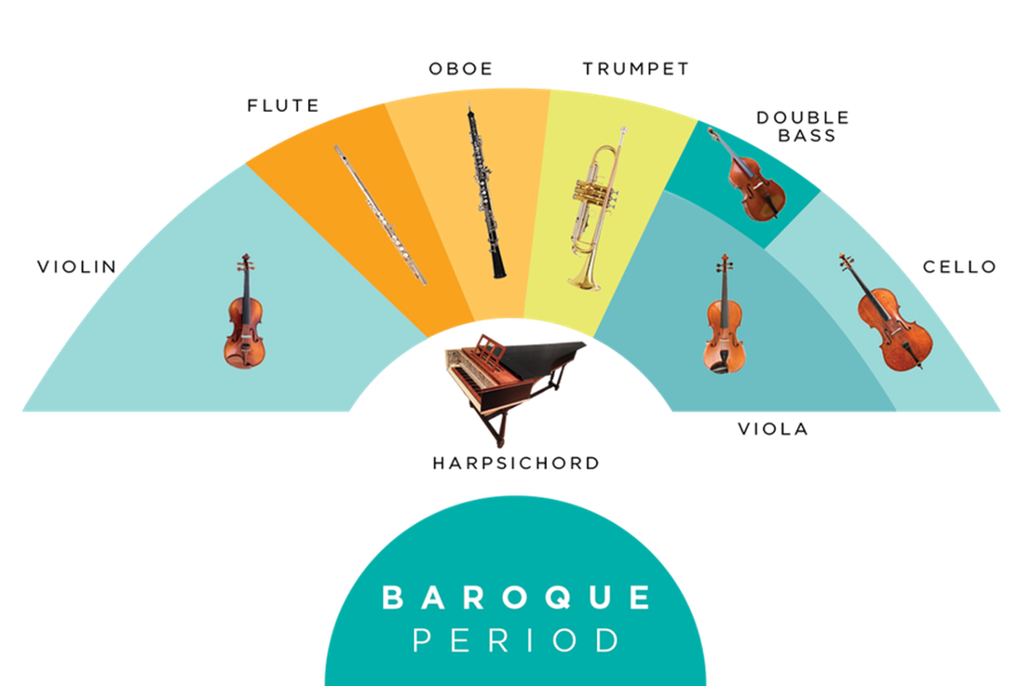
The instruments of the Baroque period
High range: violins, flutes, oboes
Middle range: violas, trumpets, horns
Low range: cello, double bass, bassoon
Percussion: timpani
Keyboards: harpsichord and organ

Slide 7
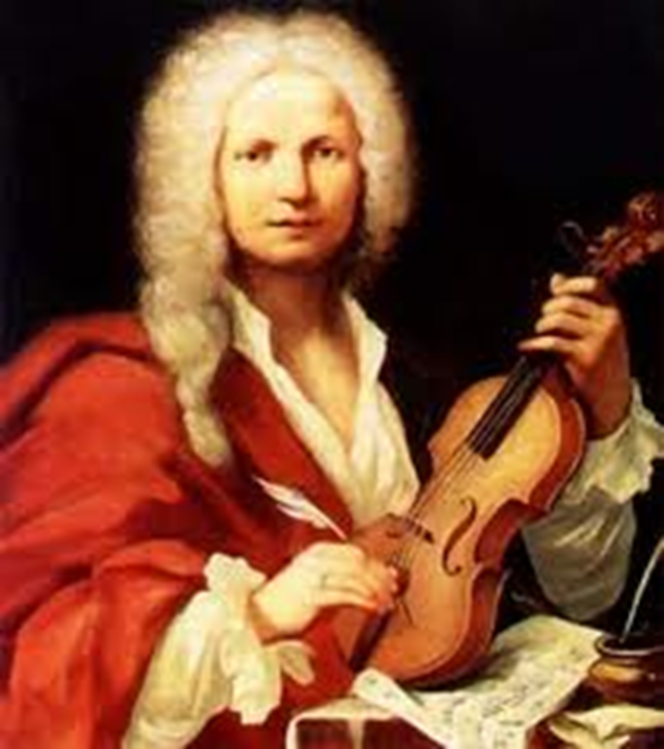
Antonio Vivaldi (1678-1741)
Italian composer and excellent violinist
He was influenced by all European music
He composed operas and concertos

Slide 8
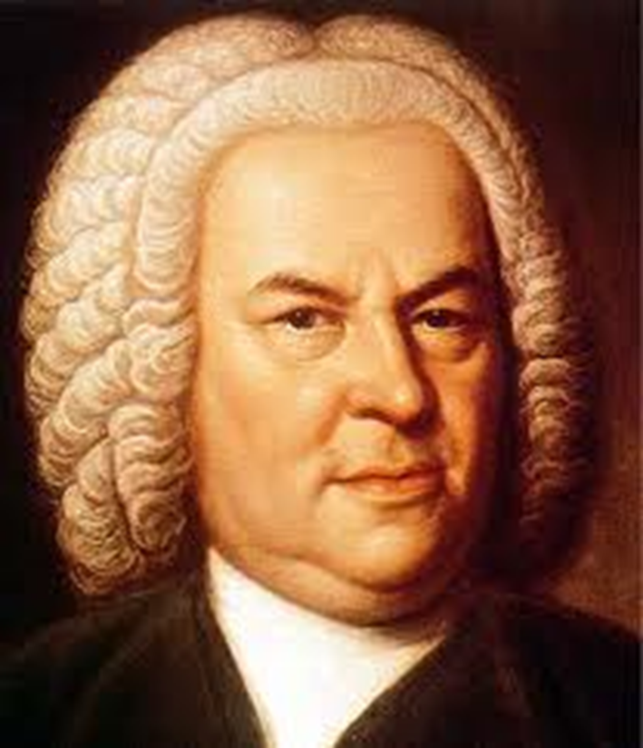
Johann Sebastian Bach (1685-1750)
German composer, organist, keyboardist and violinist
He reached the perfection of polyphony
He composed music for keyboard, organ and orchestra

Slide 9
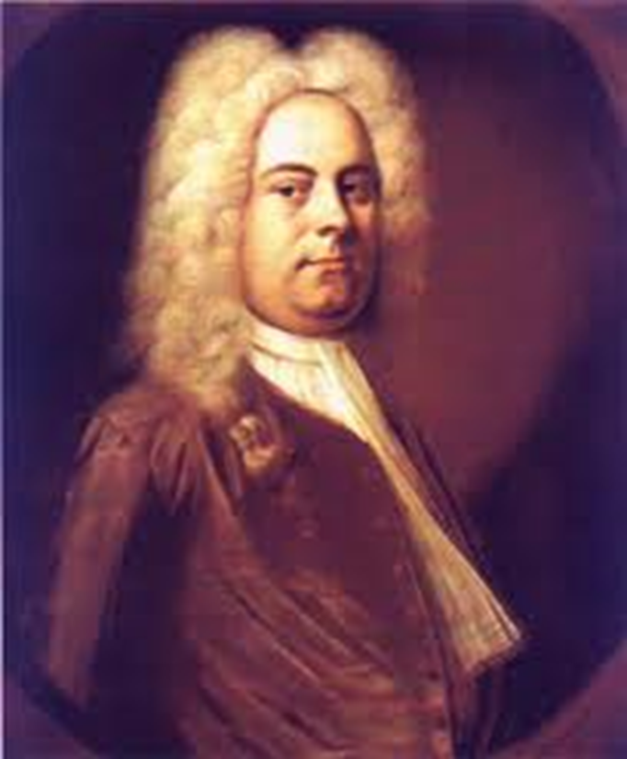
Georg Friedrich Händel (1685-1759)
German composer who lived in England
Influenced by Italian music and German polyphony
He composed operas, oratorios and concertos

