Slide 1
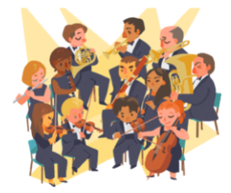
The Orchestra
for… beginners

Slide 2
Topic: The Classical orchestra
Worksheet III
The Orchestra for… beginners
PART III

Slide 3
The classical period (1750-1830)
Musical features:
Simplicity
The consistency of form
The establishment of the homophonic style of writing
The melodic and harmonic periodicity
The alternation of emotions and mood

Slide 4
Around the middle of the 18th century…
in Mannheim, Germany, a group of composers, consisting of Stamitz, Richter, Kanabich and others, cultivated mainly symphonic music and created a new type of orchestra. One of the innovations of this group was the abandonment of the basso continuo. The harmonic complement was taken over by various wind instruments, mainly two oboes and two horns. Another innovation of the Mannheim School is the introduction of the nuances of dynamics (crescendo, diminuendo) and rhythm (accelerando-rallentando). For the first time the positions of the performers on the stage were determined: on the left and right the strings, in the centre the winds and in front of them all the conductor.
Towards the end of the 18th century, the family of woodwinds (flute, oboe, clarinet, bassoon) was completed, combined in pairs. Of the brass instruments, trumpets and horns are included, and of the membrane family, drums, also in pairs.

Slide 5
Musical instruments with an ‘exotic’ colour
The impressive Turkish military bands of the Genitsars, who became popular in Central Europe in the mid-18th century, influenced many of the compositions of the period with their lively percussion timbres. Among the instruments used by Western composers (Haydn, Mozart, Beethoven, etc.) when they wanted to add some 'exotic' colour to their music were the triangle, the cymbals, the tambourine, the great tambourine, all taken from the Turkish band.

Slide 6
Musical forms:
Sonata
Quartet
Symphony
Concerto
Opera buffa
Singspiel

Slide 7
The classical orchestra
The classical orchestra had 30 to 60 musical instruments, classified into four families: strings (1st violins, 2nd violins, violas, violoncellos and double basses), woodwinds (2 flutes, 2 oboes, 2 clarinets and 2 bassoons), brass (2 trumpets and 3 horns) and percussion (2-3 timpani).
Each family in the classical orchestra had a specific role:
the strings were the most important part, with the first violins playing the melody and the other strings providing the accompaniment,
the woodwinds were used mainly as a contrasting timbre and sometimes covered melodic parts,
the brass played in loud parts, enhancing the harmony,
timpani were occasionally used to emphasize the rhythm.
The classical orchestra evolved into an agile and timbre-rich 'musical instrument' with which composers could express their musical ideas.

Slide 8
The Classical Orchestra
Two groups of violins are established
The role of the winds is expanded
Two families of wind instruments are established:
the woodwinds: flute, oboe, clarinet, bassoon
the brass: trumpets, horns
The symphonic drums (timpani) are established
The result of all this is that the orchestra gains more volume and intensity

Slide 9
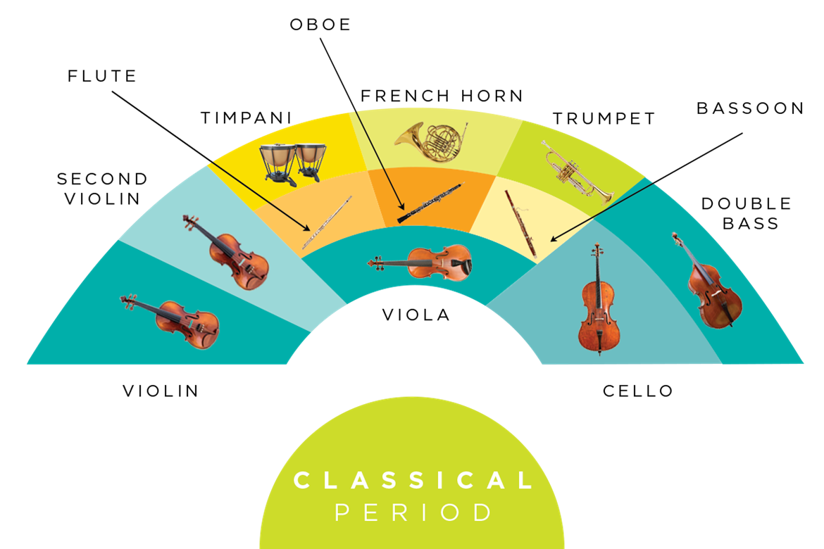
The Classical Orchestra I (18th century)

Slide 10
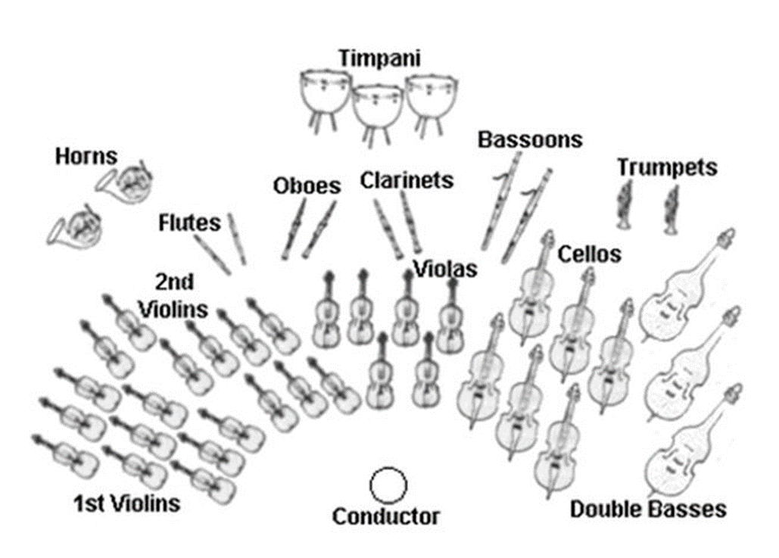
The orchestra of the classical period (2nd half of the 18th century)
In the Classical orchestra are established:
Two groups of violins (first and second)
Two families of wind instruments (the woodwinds: flute, oboe, clarinet, bassoon and the brass: trumpets, horns)
The symphonic drums (timpani)
The result: the orchestra gains more volume and intensity
Strings: 22 violins, 8 violas, 8 cellos, 6 double basses
Woodwinds: 2 flutes, 2 oboes, 2 clarinets, 2 bassoons
Brass: 2 horns, 2 trumpets
Percussion: 2 timpani
Keyboard: Harpsichord (phased out in late 1700s)

Slide 11
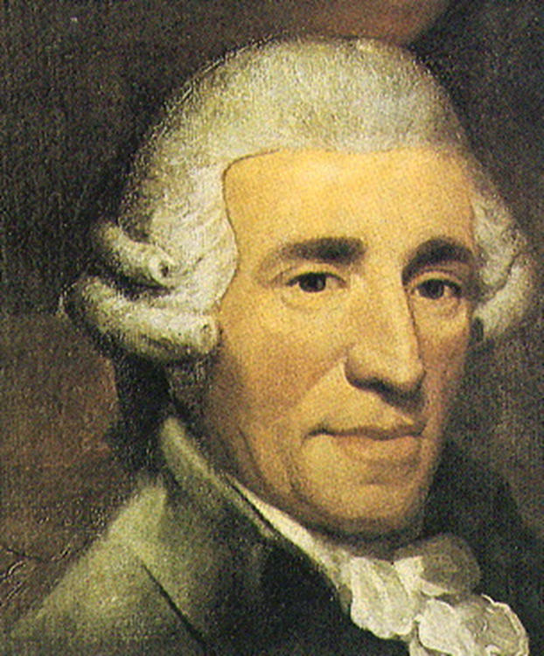
Joseph Haydn (1732-1809)
A prolific composer
He wrote symphonies, piano and chamber music works

Slide 12
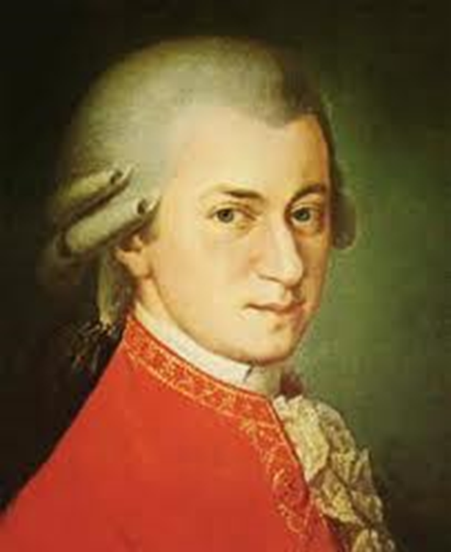
Wolfgang Amadeus Mozart (1756-1791)
Prodigy child
Excellent improviser
He wrote sonatas, symphonies, concertos, operas (all genres)

Slide 13
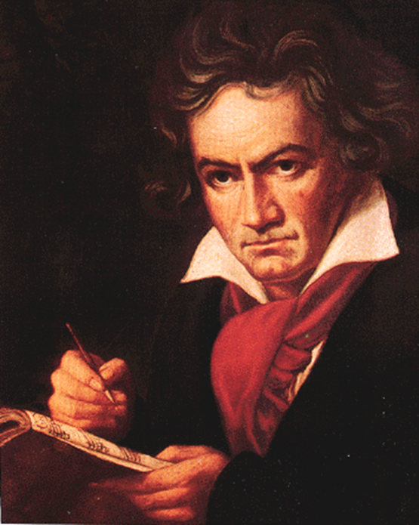
Ludwig van Beethoven (1770-1827)
Prepare for the romantic period
He wrote symphonies, piano and chamber music works

