Slide 1
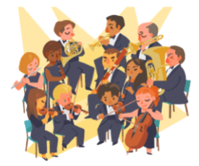
The Orchestra
for… beginners

Slide 2
Topic: The Romantic orchestra
Worksheet IV
The Orchestra for… beginners
PART IV

Slide 3
The Romantic era (1830-1890)
Romanticism (also known as the Romantic era) was an artistic, literary, musical, and intellectual movement that originated in Europe towards the end of the 18th century, and in most areas was at its peak in the approximate period from 1800 to 1850.
Romanticism was characterized by its emphasis on emotion and individualism, idealization of nature, suspicion of science and industrialization, and glorification of the past with a strong preference for the medieval rather than the classical.
It was partly a reaction to the Industrial Revolution, the social and political norms of the Age of Enlightenment, and the scientific rationalization of nature—all components of modernity.
It was embodied most strongly in the visual arts, music, and literature, but had a major impact on historiography, education, chess, social sciences, and the natural sciences.
It had a significant and complex effect on politics, with romantic thinkers influencing conservatism, liberalism, radicalism, and nationalism.

Slide 4
The Romantic Orchestra (19th century)
The Romantic orchestra increased the number of instruments and emphasized mainly brass and piano.
The number of strings increased (50-60 instruments).
Instruments were added to the woodwind family (piccolo flute, English horn, mb clarinet, bass clarinet, contra bassoon).
The brass family was stabilized (3 trumpets, 4-6 horns, 2-3 trombones and 1 bass trombone, 1 tuba).
Instruments were added to the percussion family (bass drum, cymbals, snare drum, triangle, tambourine, etc.)

Slide 5
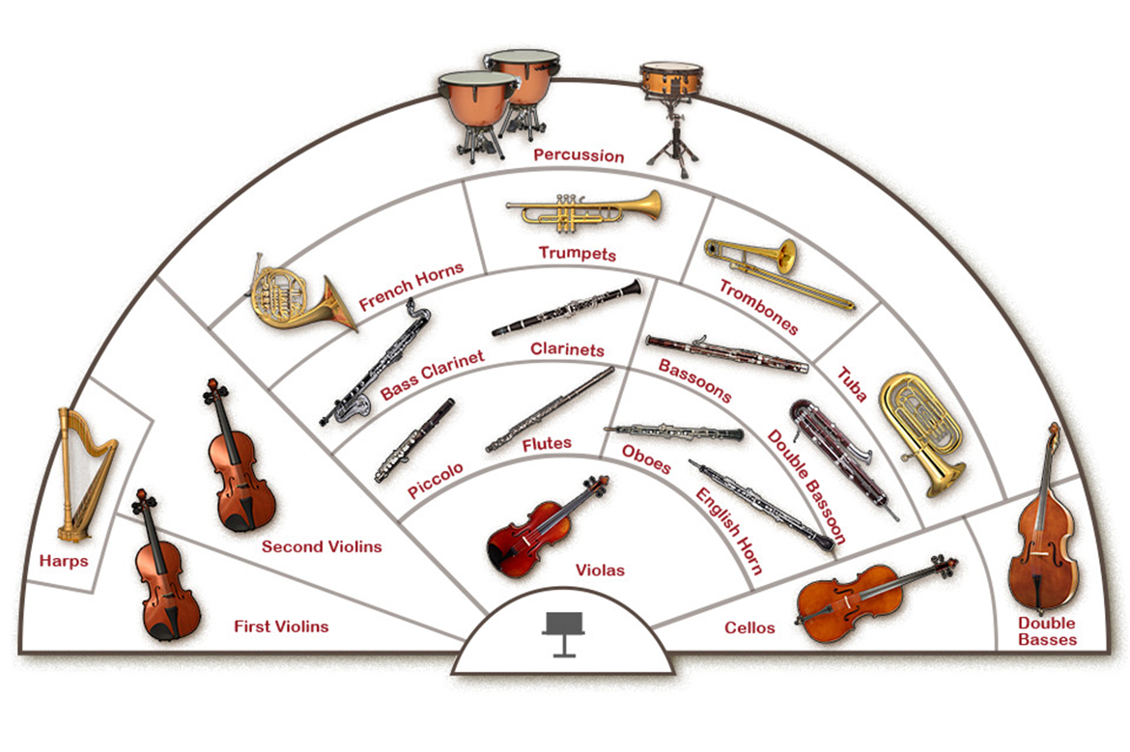
The Romantic Orchestra (19th century)

Slide 6
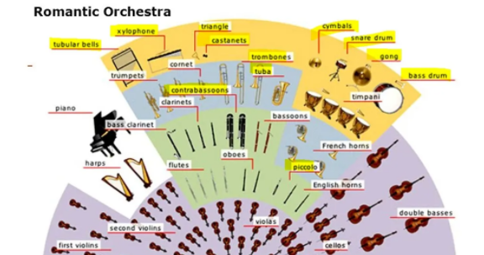
New entries

Slide 7
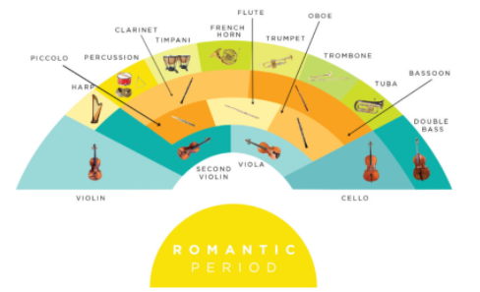

Slide 8
Early and late romantic orchestra
Early romantic:
Strings: 26 violins, 10 violas, 8 cellos, 6 double basses
Woodwinds: piccolo, 2 flutes, 2 oboes, 2 clarinets, 2 bassoons, contrabassoon
Brass: 4 horns, 2 trumpets, 3 trombones, tuba
Percussion: timpani, snare drum, bass drum, cymbals, triangle, tambourine, glockenspiel
Late romantic:
Strings: 30 violins, 12 violas, 12 cellos, 10 double basses
Woodwinds: 1-2 piccolo, 3-4 flutes, 3-4 oboes, 3-4 clarinets, 3-4 bassoons, contrabassoon
Brass: 4-8 horns, 3-6 trumpets, 3-4 trombones, 1-2 tubas
Percussion: 4+ timpani, snare drum, bass drum, cymbals, tam-tam, triangle, tambourine, glockenspiel, xylophone, tubular bells
*piano, celesta, 2 harps

Slide 9
Musical features
Expression of emotions
Intense virtuosity
Adoption of traditional elements (national schools)
Programme music: music based on a poetic idea, the plot and development of a historical event or myth, in free form

Slide 10
Musical genres-composers
Concerto (Mendelssohn, Schumann, Liszt)
Opera (Verdi, Berlioz, Puccini)
Ballet (Tchaikovsky)
Drama (Wagner)
Chamber music (Chopin, Liszt)

